Slide 1

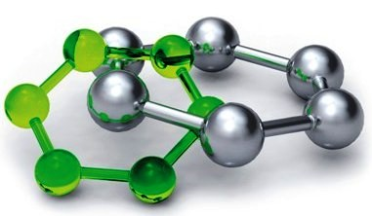
Development of Diagnostic Sensors for Industrial Applications
in Laboratory of Smart Sensors
RG 2-2 Cybernetics in Material Science
Zdeněk Havránek, Ph.D. 7th November 2013

Slide 2


Content of the Presentation
Introduction of the laboratory – our scope and aims, our team
Present research activities and ongoing projects
  Sensors for acoustic emission measurement – towards wideband transducers
  Piezoelectric knock sensors – diagnostic methods for failure prediction
  Sensor arrays for sound source localization – signal processing and calibration
  Fully digital current and voltage measurement system for mid-voltage substation
  Experimental diagnostic of mechanical resonant frequencies on small turbine
Past projects and projects waiting on list
Projects in preparation, future directions
Latest publications

Slide 3
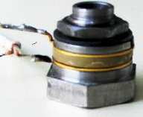
Introduction of the Laboratory
Scope:
one of four expert teams in the research group „Cybernetics in Material Science“
in the framework of the research programme „Advanced Materials“
Aims:
research and development of specialty smart sensors
application of new and advanced methods for signal processing
methods and aparatus for noncontact/nondestructive diagnostics (with autocalibration, without disassembly, including materials)
new methods for processing of data from sensor arrays (holography) and in-situ calibration
application on new materials for sensors, optimization of energy consumption, energy harvesting
support other research teams with knowledge in measurement of non-electrical quantities

Slide 4
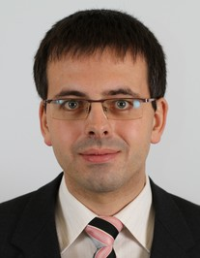
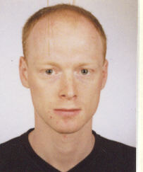
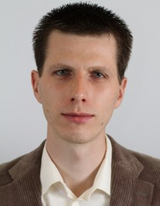
Team
Zdeněk Havránek, Ph.D.
- acoustic and vibration sensor systems
- analog signal processing, smart sensors interfacing
- sensors’ arrays data processing, virtual instrumentation
Stanislav Klusáček, Ph.D.
- nondestructive vibration diagnostics
- research and development of sensors for diagnostics
- sensors with selfdiagnostics, autocalibration, without disassembly
Jiří Fialka, Ph.D. student
- sensors for acoustic emission
- application of piezoelectric materials in sensors
Support in research and development:
Jan Galia - FPGA based design, implementation of digital signal processing
Pavol Španihel – ARM based embedded systems, network protocols

Slide 5
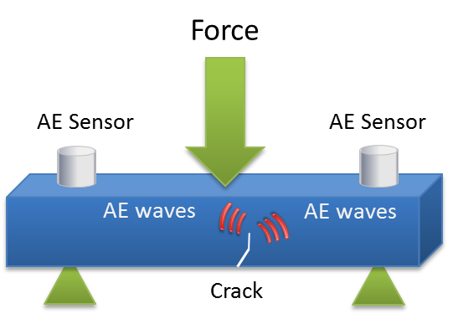
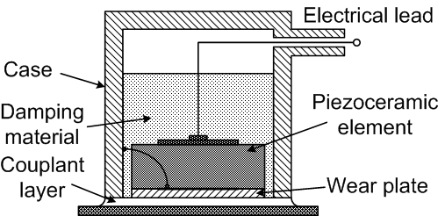
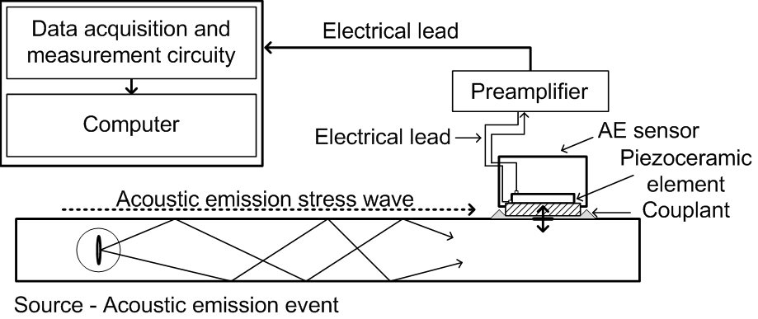
Acoustic Emission
Principle of generation and sensing
Acoustic emission waves are transient elastic waves generated by crack growth in a solid material under stress or by leaks, friction, knocks, chemical reactions, changes of size of magnetic domains, etc.
Sensing of acoustic emission waves are usually made by piezoelectric sensors.
Piezoelectric AE sensors
AE measurement aparatus

Slide 6
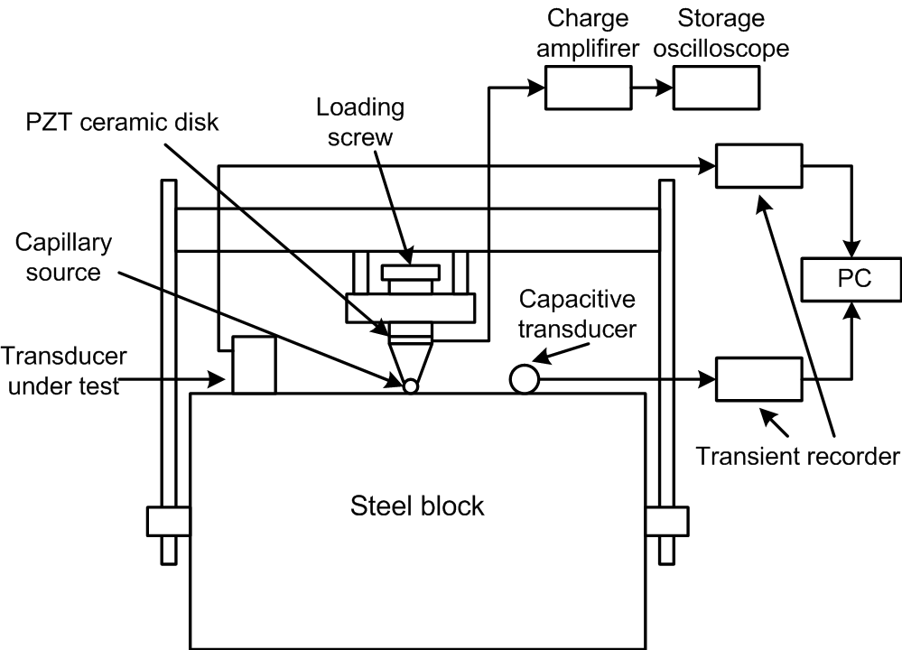
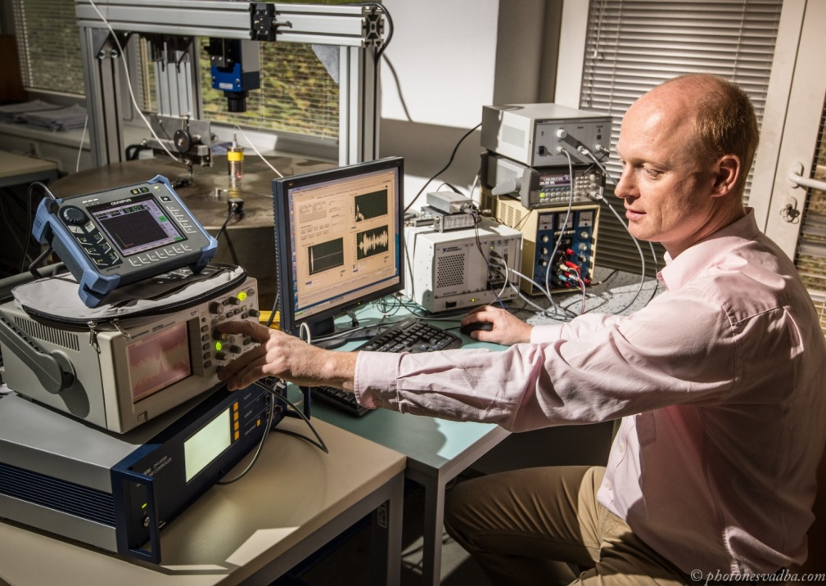
Calibration of AE sensors
Primary calibration methods
  Step function calibration (ASTM 1106, NIST)
  Reciprocity calibration (ISO/TR 13115, NDIS 2109)
      wideband excitation, two methods successfully implemented
      - Hatano (all transducers reciprocal)
      - Hill-Adams (only two reciprocal transducers needed)
  Longitudinal wave calibration (NPL)

Slide 7
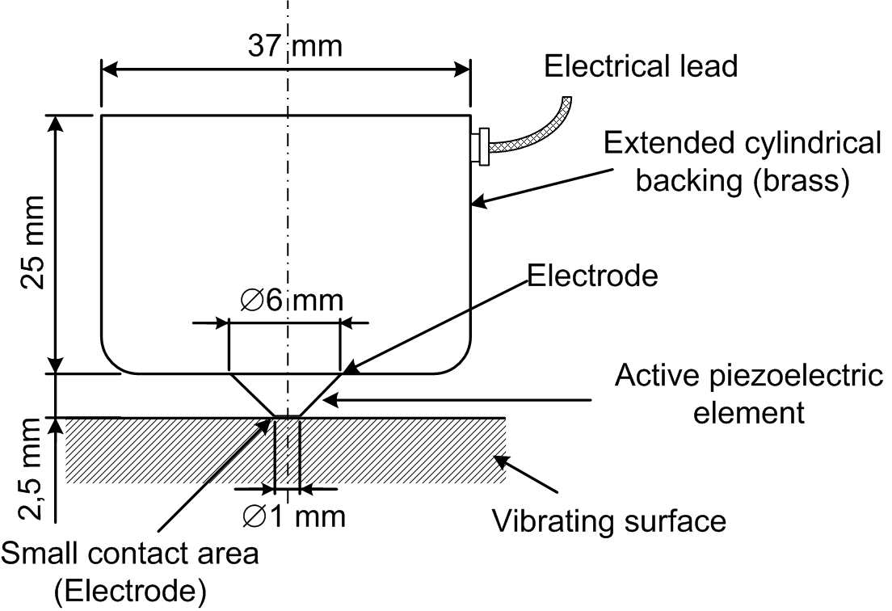
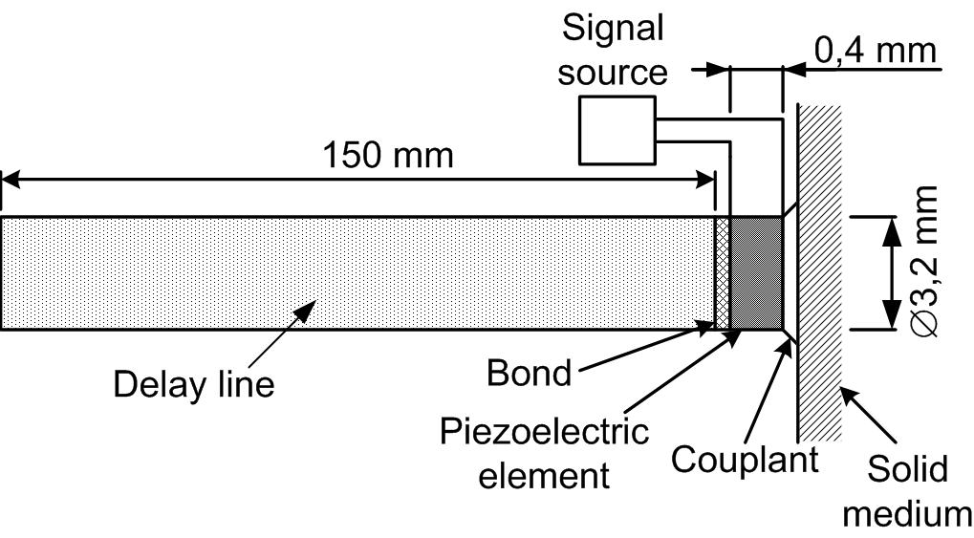
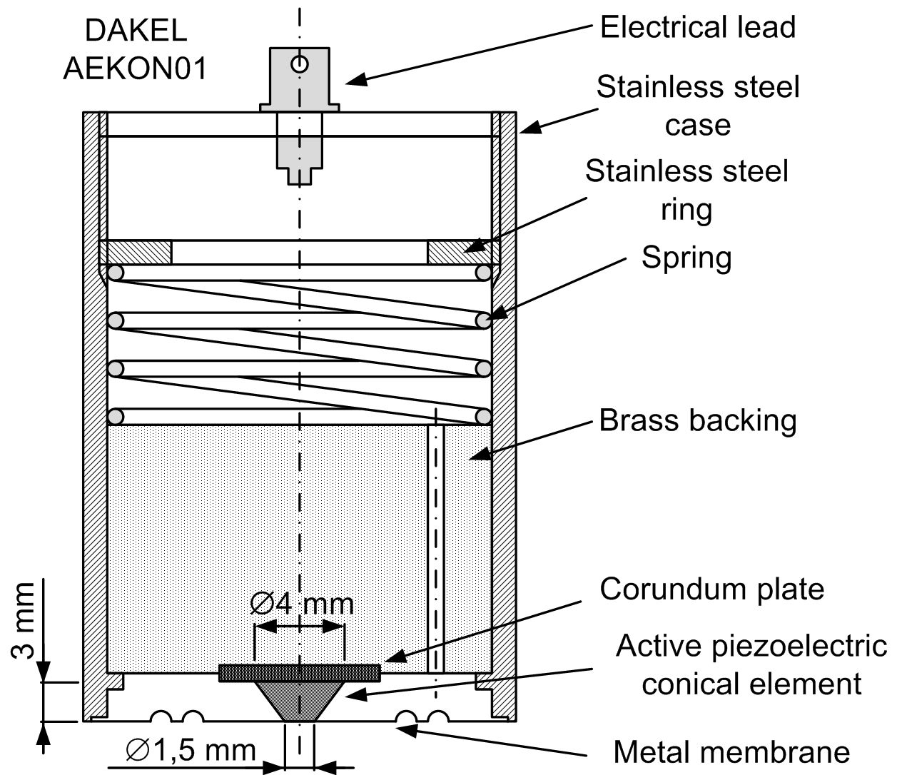
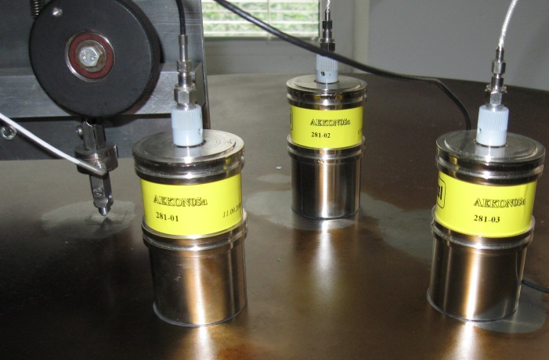
Towards broadband AE sensors
Known principles
Pinducer-like AE sensor
NIST sensor with conical piezoelement
DAKEL AEKON05A reference sensors with conical element – calibration at our workplace

Slide 8
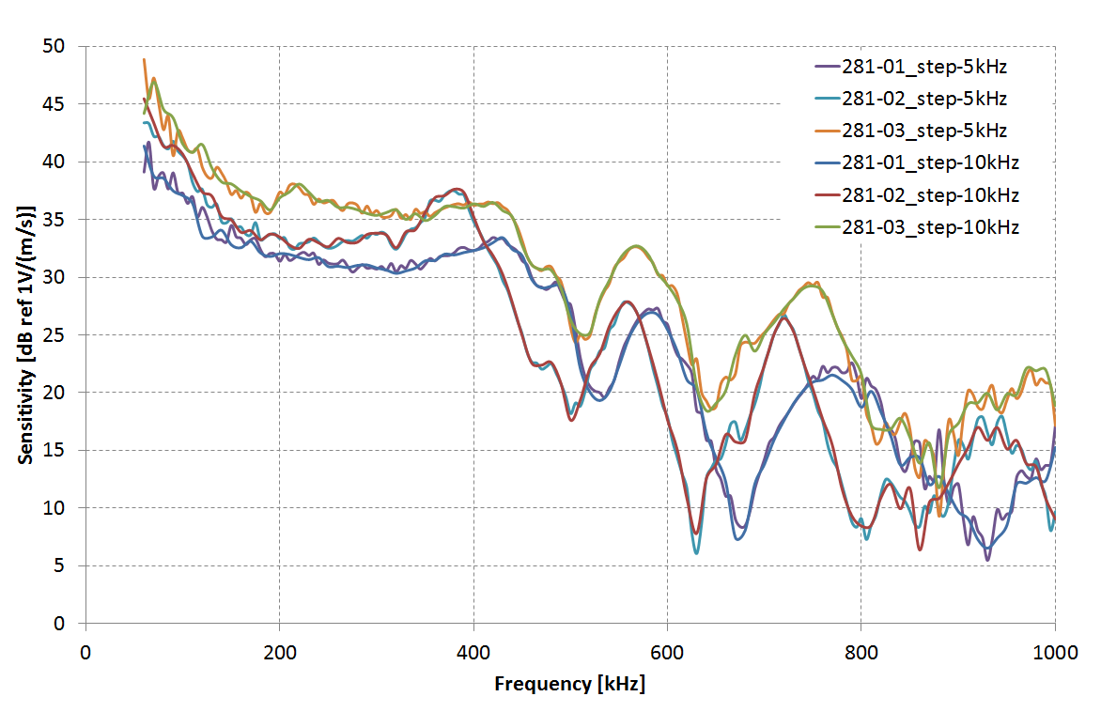
Towards broadband AE sensors Research on conical piezoelement
  Measurement and analysis of frequency response of sensors with conical elements produced by machining
    three reference sensors with conical active element measured by reciprocity technique
  Unknown relationship between size and shape of the element and its frequency response
  =>Unable to produce sensors with required frequency response
  (to control the sensitivity)

Slide 9
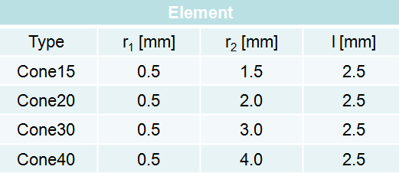
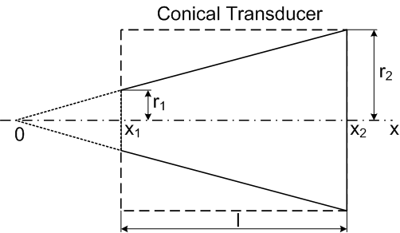
Towards broadband AE sensors
New conical type transducers
  Design and fabrication of new set of conical elements to find exact relationship between shape and frequency response
  New dimensions of conical type transducers designed
  Fabrication of new conical piezoelectric elements in cooperation with research team of Hana Hughes and Tim Button – first samples received from University of Birmingham
  Sensor housing now in production
  Measurement and evaluation of performance
  of newly designed transducers in near future
  Possible complications – inaccurate conical shape, difficult electrodes contacting

Slide 10
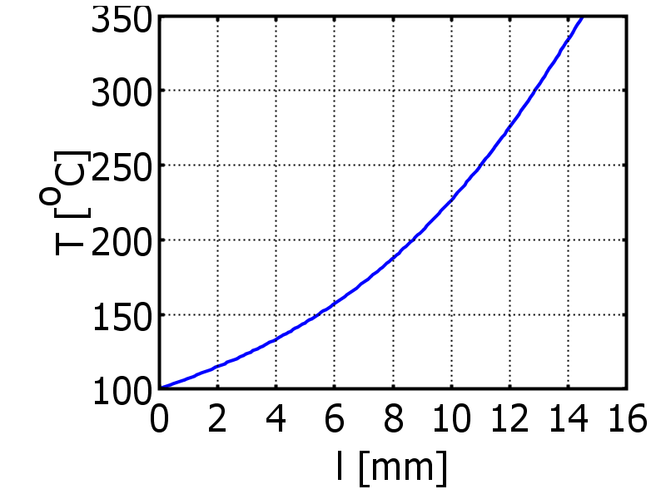
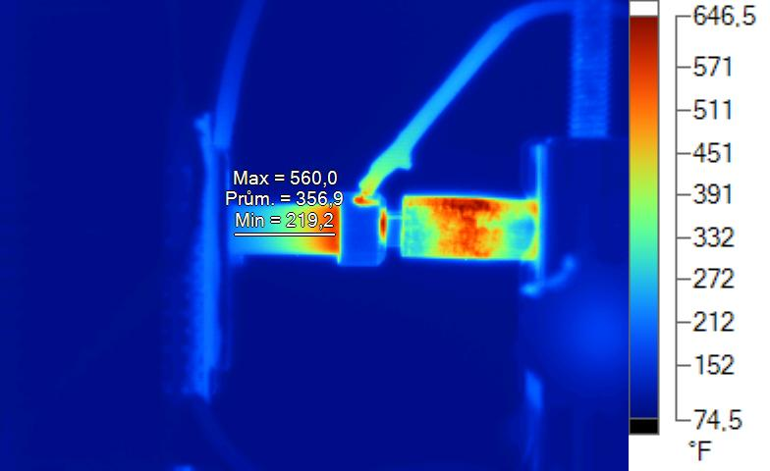
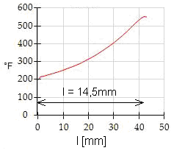
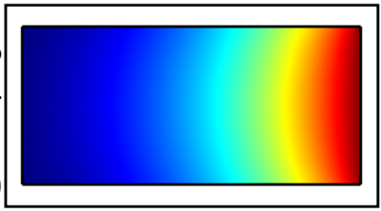
Towards broadband AE sensors
Partial depolarization by thermal wave
  PZT ceramics, cylinder ∅ 7 mm, height 14,5 mm
  Hard to control temperature distribution through ceramic piece
  Using temperature controlled chamber for understanding the phenomena
COMSOL model
Picture from thermal analysis and measured distribution

Slide 11
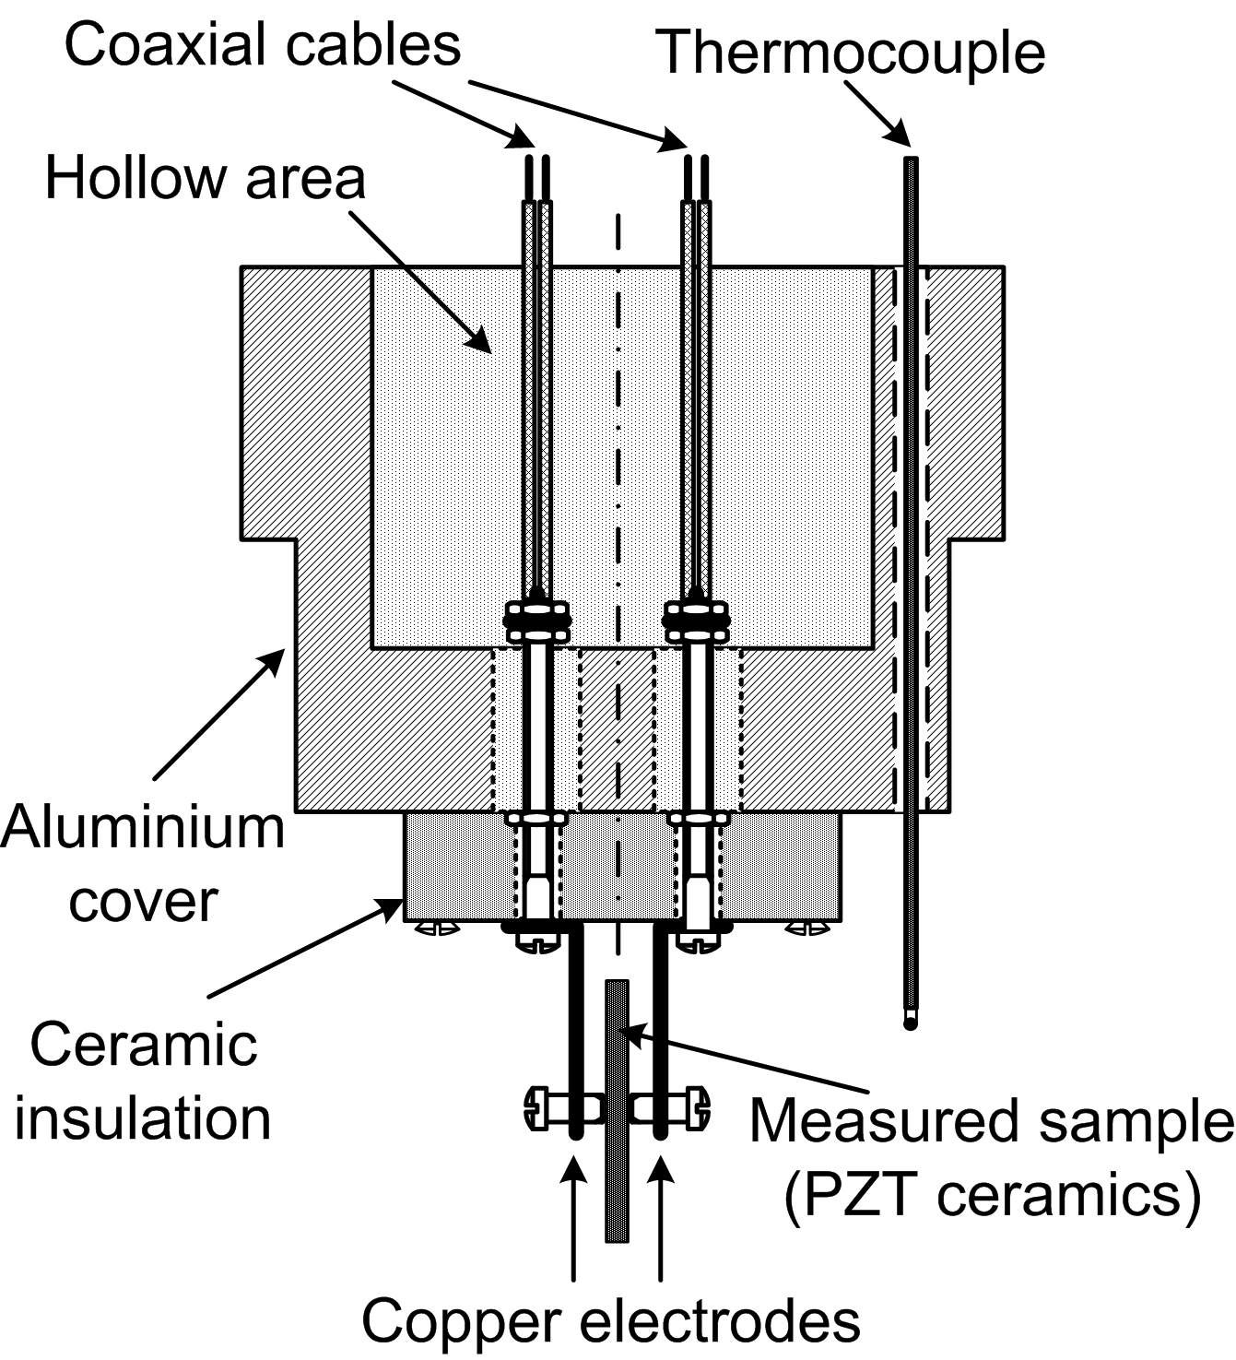
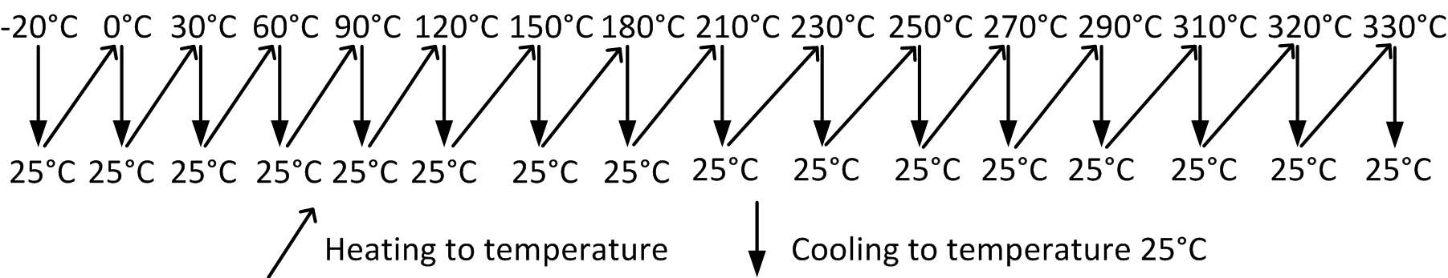
Characterization of PZT ceramic for AE sensors
Influence of temperature cycling on the coefficients of the PZT ceramics
  Several sample types – thin plate, thin disc, cylinder
  Special sample holding clamps for measurement in temperature chambers
  Frequency characteristics of electrical impedance of samples measured

Slide 12
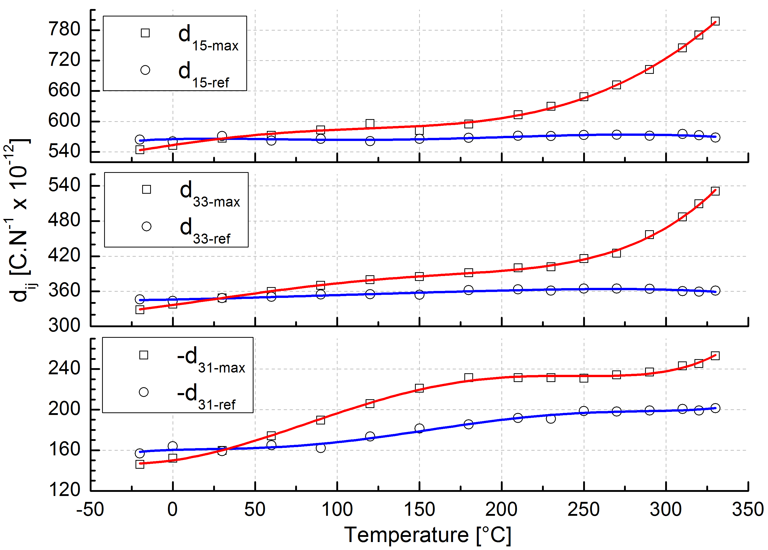
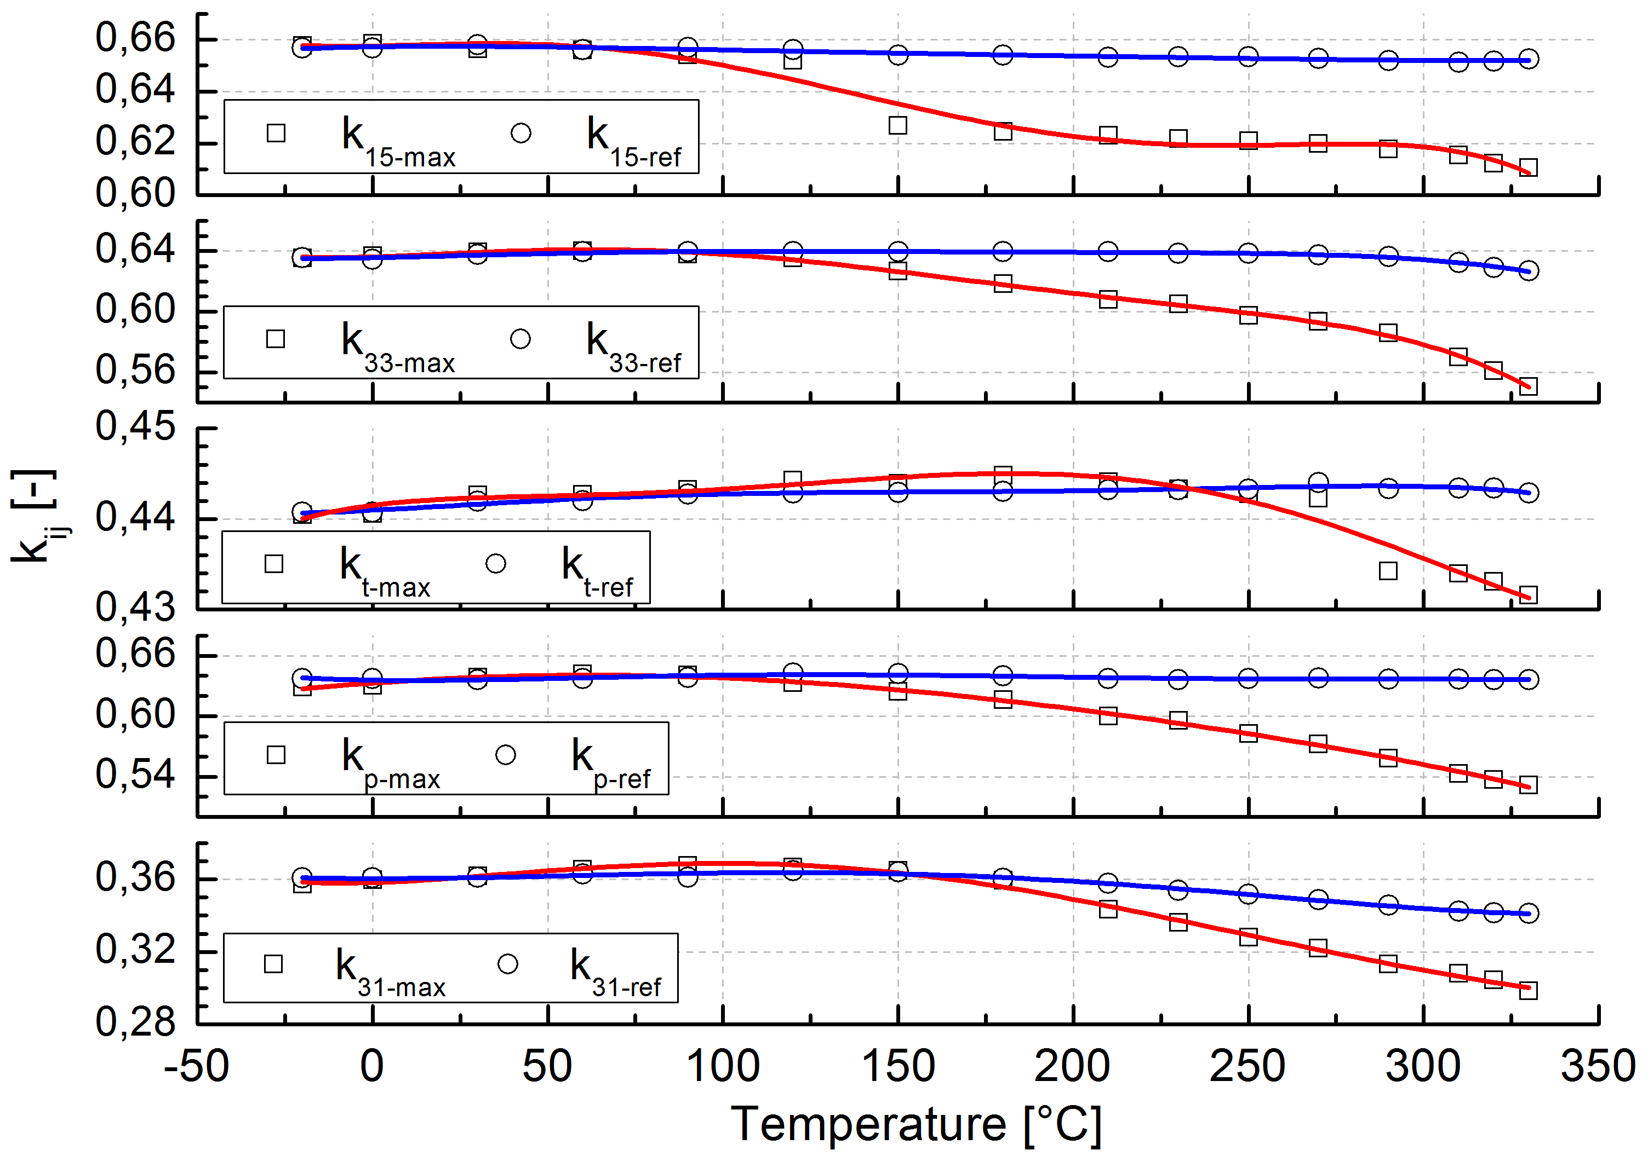
Characterization of PZT ceramic for AE sensors
  Calculation of piezoelectric charge coefficients dij, elastic coefficients, relative dielectric permittivity, electromechanical coupling coefficients kij
  Recrystallization observed near Cuire point (above 320°C)

Slide 13
Characterization of PZT ceramic for knock sensors
  Evaluation of temperature dependence of resonant and antiresonant frequencies of piezoelectric knock sensors with ring PZT element
  Different sensors with various extent of damage have been examined
    Not damaged sensors (ring SONOX, commercial Bosch, uncovered prototype)
    Prototype with cracked piezoceramic ring
    Prototype with broken piezoceramic ring
  Impedance measurement of PZT element
  before and after temperature stress (-20°C to 140°C)

Slide 14
Characterization of PZT ceramic for knock sensors
  Resonant frequencies change in sensors with no obvious damage
  Ring SONOX BOSCH Uncovered prototype
  Resonant frequencies change in sensors with crack (left) and with broken ring (right)

Slide 15
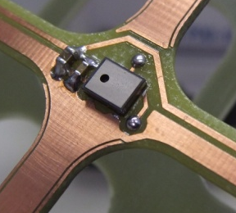
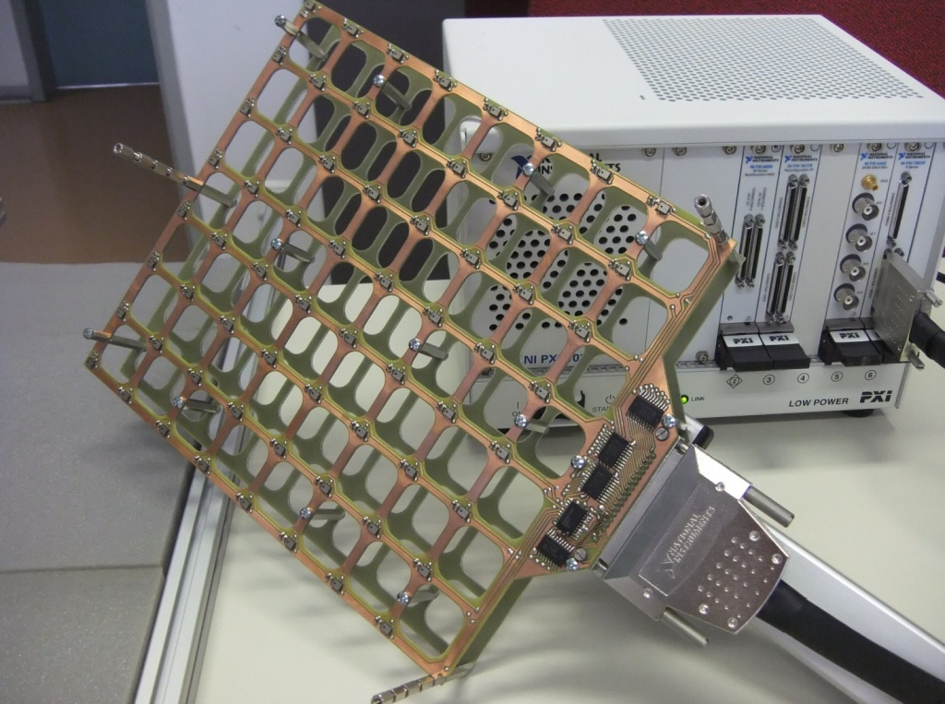
Sensor arrays for sound source localization
Noncontact diagnostic system for noise and vibration analysis
Utilization of MEMS sensors in matrix microphone array
64 (128) sensors in (2x)8x8 matrix, spacing 30 mm, frequency limit of 5 kHz
Development of efficient digital signal processing
decimation and filtration in FPGA, using CIC and FIR filters
real-time analysis and visualization of sound fields on NI PXI system
Working on algorithms for acoustic holograpahy calculation with cheap MEMS sensors

Slide 16
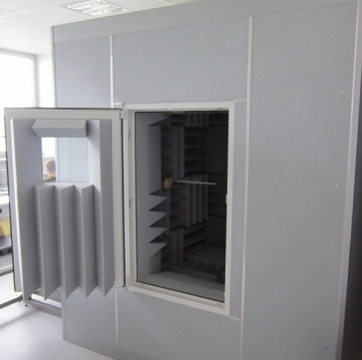
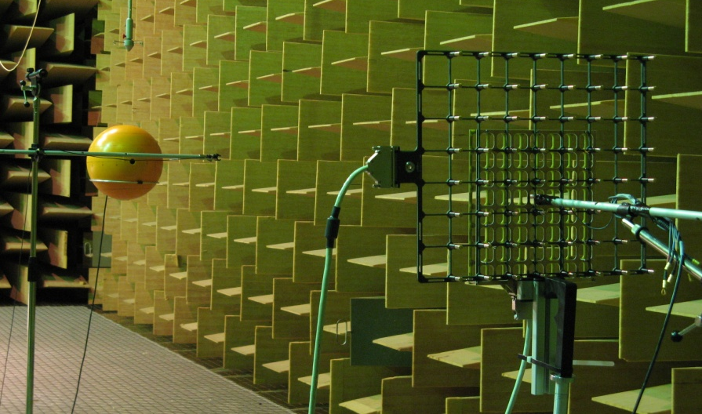
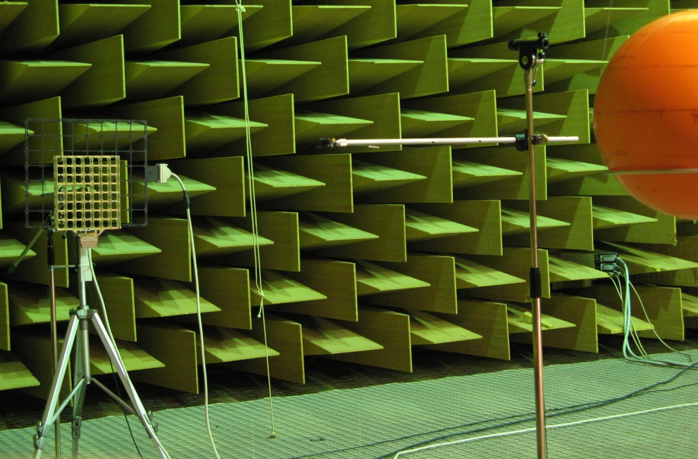
Sensor arrays for sound source localization
Research and development of full array calibration methods
  In-situ phase and amplitude calibration of all microphones in array
Comparison with reference laboratory microphone array equipped with precise capacitive transducers
Evaluation of reference sound source construction
  B&K omnisource, monopole on the sphere,monopole in the sphere
Unique measurements in large anechoic chamber (1000 m³)
  Acoustic Technology Department, DTU Copenhagen
  Processing of data in progress, comparison with our small workplace

Slide 17
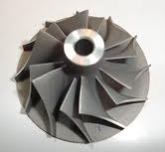
Other ongoing projects
Sensor system for current/voltage measurement in mid-voltage substation
  precise characterization of Rogowski coil sensor
  digitalization of direct analog output of Rogowski coil
  and voltage divider
  processing digital data with precise timestamp
  and connection to process bus
  ongoing project of Technological Agency of Czech Republic
  close cooperation with one of the main supplier
  of current and voltage sensors – ABB Brno
Analysis of resonant frequencies of blades on small turbine for automotive turbochargers
challenge – high resonant modes near 50 kHz
successful vibration excitation examined (shaker, modal hammer)
measurement of in pm resolution with Polytec OFV5000 vibrometer
comparison of single point and differential laser measurement

Slide 18
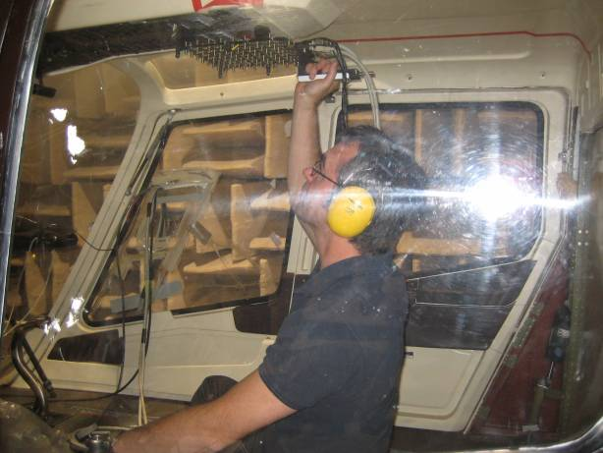
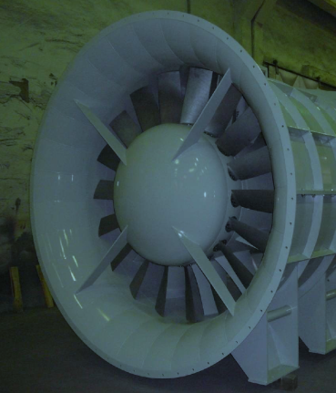
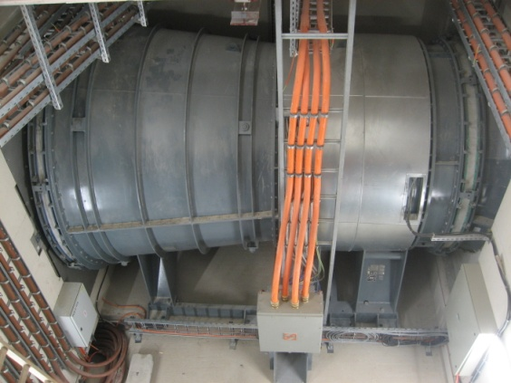
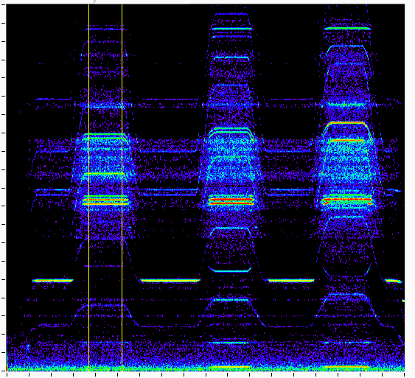
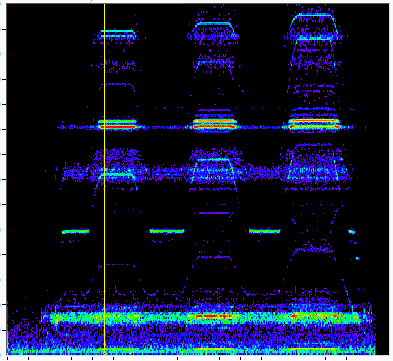
Selected past projects
Methods and measurement systems for localization and characterization of sound sources inside aircraft and helicopter cabins
  Participation in FP6 project CREDO
  Main partners Bruel&Kjaer, EADS/Airbus, Alenia, Dassault
  Research on methods and algorithms for acoustic signals
  data processing from matrix of acoustic sensors
  – acoustic holography with dual-layer microphone array
Vibration analysis of large ventilation unit
for road tunnels – installation in Dobrovského tunnels in Brno
  Measurement of vibration of ventilation unit housing in different modes of operation
  Analysis of spectrograms, brief ODS analysis, detection of resonating parts

Slide 19
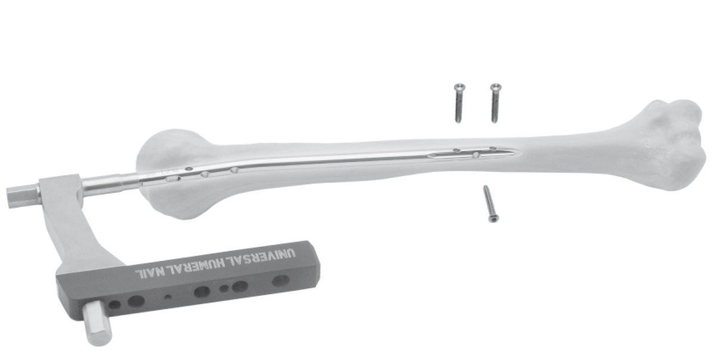
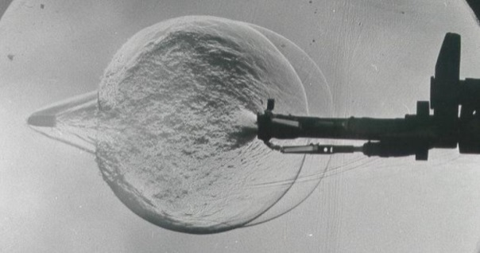
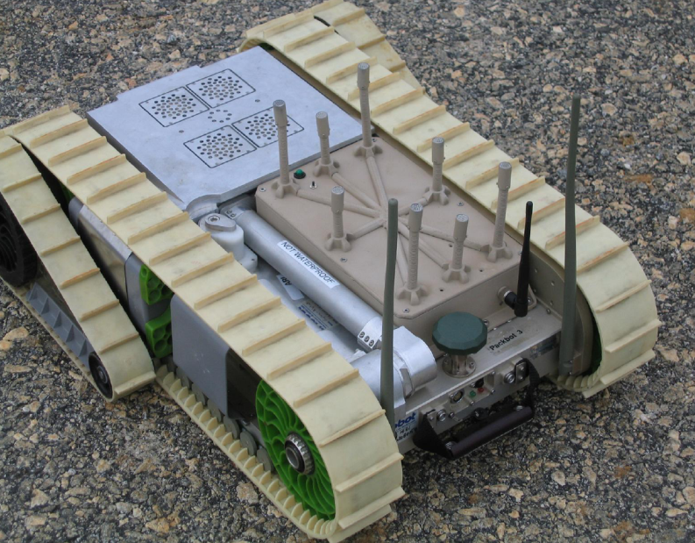
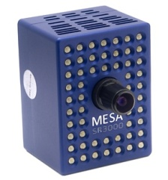
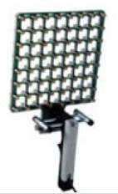
Projects waiting on list
  Localization methods for placement of nails during surgery operations
    initial study/expertise of perspective methods for localization of holes in stiffening nails in bones (excluding X-ray)
  Acoustic localization of gunshot position (for mobile robots)
    study of methods for measurement and analysis of Mach (shock) wave and muzzle wave
  Sensor system for noncontact vibration/noise diagnostics
    data fusion of acoustic measurement and proximity measurement
    acousto-optical effect utilization for sound field mapping and sources characterization
  Methods and methodology for machine monitoring
    estimation of resonance frequency of machine support on heavy basement

Slide 20
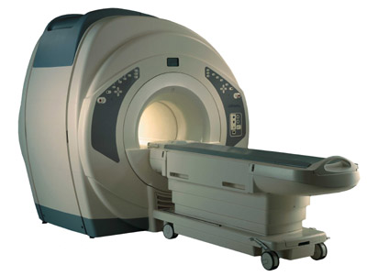
Projects in preparation
  MEMS gyro for aerospace applications - evaluation and testing
    Cooperation with Honeywell Brno
    TA Centre of Competence – submitted proposal
      advanced sensor design, signal processing methods, evaluation and testing
      focusing on MEMS sensors and fiber optic sensors
      applications in aerospace, railways and buildings
      Project partners - CTU Prague, AZD, Honeywell, Safibra, SQS, WBU Pilsen)
    Measurement of human body motion during magnetic resonance imaging
    Cooperation with CEITEC MU – RG 6-2 Multi-modal and Functional Neuroimaging
    Application of accelerometers in high magnetic field
    Processing of data from accelerometer measurements
    Optical measurement principle – stereovision with laser matrix

Slide 21
Latest publications
Klusacek, S., Fialka, J., Havranek, Z., Benes, P. “An experimental study of temperature effect on material parameters of PZT ceramic ring used in knock sensors,” Accepted paper for publication in proceedings of International Sensing Technology Conference, ICST 2013, pp. 1-6.
Klusacek, S., Fialka, J., Havranek, Z., Benes, P. “Experimental methods for testing active element of piezoelectric knock sensor by using temperature dependences,” Proceedings: 20th International Congress on Sound and Vibration, International Journal of Acoustic and Vibration. US: International Institute of Acoustic and Vibration, 2013, pp. 1-7. ISBN: 978-616-551-682-2. ISSN: 2329-3675.
Havranek, Z., Benes, P., Sysel, P. “Analysis of operational deflection shapes of the shaker armature near upper frequency limit,” Proceedings: 20th International Congress on Sound and Vibration, International Journal of Acoustic and Vibration. US: International Institute of Acoustic and Vibration, 2013, pp. 1-8. ISBN: 978-616-551-682-2. ISSN: 2329-3675.
Fialka, J., Benes, P. “Comparison of methods for the measurement of piezoelectric coefficients,” IEEE Transactions on Instrumentation and Measurement, vol. 62, issue 5, pp. 1047-1057, 2013.
Klusacek, S., Havranek, Z. “Experimental diagnostic methods for vibration piezoelectric sensors,” INTER- NOISE 2012: Proceedings – International Conference on Noise Control Engineering, New York - Institute of Noise Control Engineering, 2012,pp. 1-10. ISSN: 0736-2935.
Havranek, Z., Klusacek, S. “Experimental evaluation of methods for estimation of regularization in acoustic holography with MEMS sensor array,“ INTER- NOISE 2012: Proceedings – International Conference on Noise Control Engineering, New York - Institute of Noise Control Engineering, 2012, pp. 1-11. ISSN: 0736-2935.
Fialka, J., Benes, P. “Measurement of Piezoelectric Ceramic Parameters - A Characterization of the Elastic, Dielectric and Piezoelectric Properties of NCE51 PZT”. 13th International Carpathian Control Conference (ICCC 2012), 2012, pp. 147-152. ISBN: 978-1-577-1866-3.

Slide 22
Thank you for you attention.
Please, ask questions…
Cybernetics in Material Science Research Group
Laboratory of Smart Sensors
Central European Institute of Technology
Brno University of Technology
Technická 3082/12, room SD3.114
616 00 Brno, Czech Republic
www.ceitec.cz
zdenek.havranek@ceitec.vutbr.cz

