Slide 1
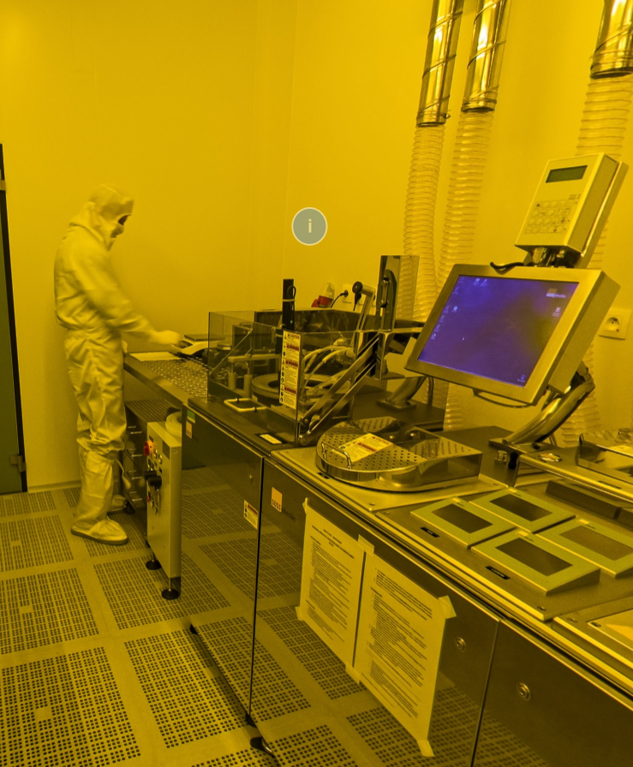
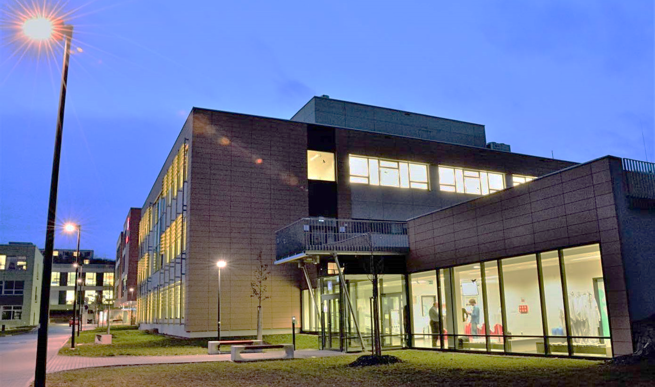
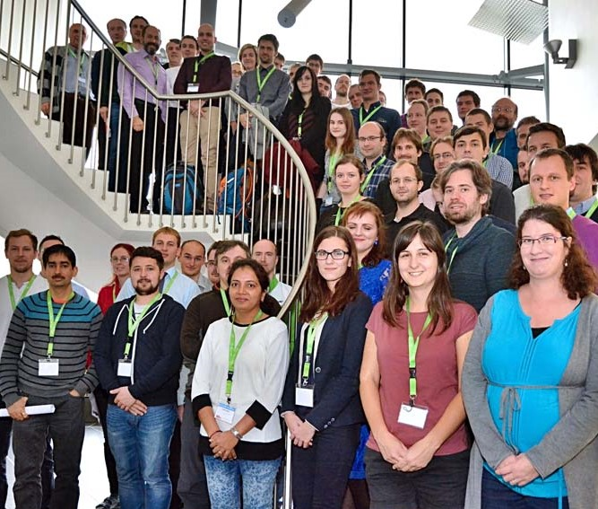
CEITEC Nano Research Infrastructure
Michal Urbánek
http://nano.ceitec.cz

Slide 2
CEITEC Nano Research Infrastructure
The CEITEC Nano is Czech Republic’s largest cleanroom nanocentre, acknowledged by Ministry of Education of the Czech Republic as Large Infrastructure for Research, Experimental Development and Innovation.
It is single-sited, flexible, multi-material, multipurpose (not CMOS-only) user facility providing services for internal and external users from academia and industry. We typically serve for physics, material science and electronics research, however bio-related and medicine research is also possible.
Main focus is excellent basic research, but we can offer up to 20% of our capacity to industry.
Joint laboratory of Brno University of Technology and Masaryk University.
Build within the CEITEC project (2011 – 2015), initial investment of approx. 40M€ (16M€ cleanrooms, 24M€ equipment).
It is independently financed (75-90% of the budget) via national programme for large research infrastructures. This funding depends mainly on number of users and publication of the users.
Running Costs
1.2 M€/year
New Investments
~1.5 M€/year

Slide 3
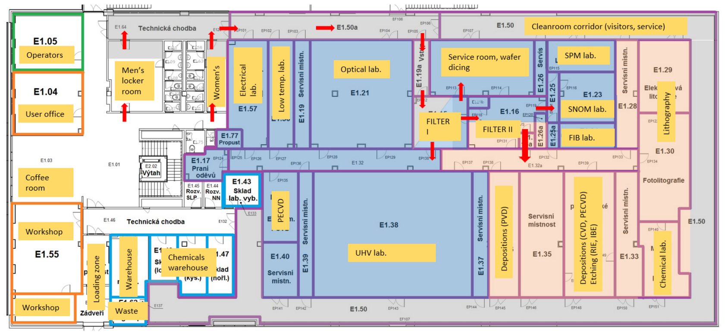
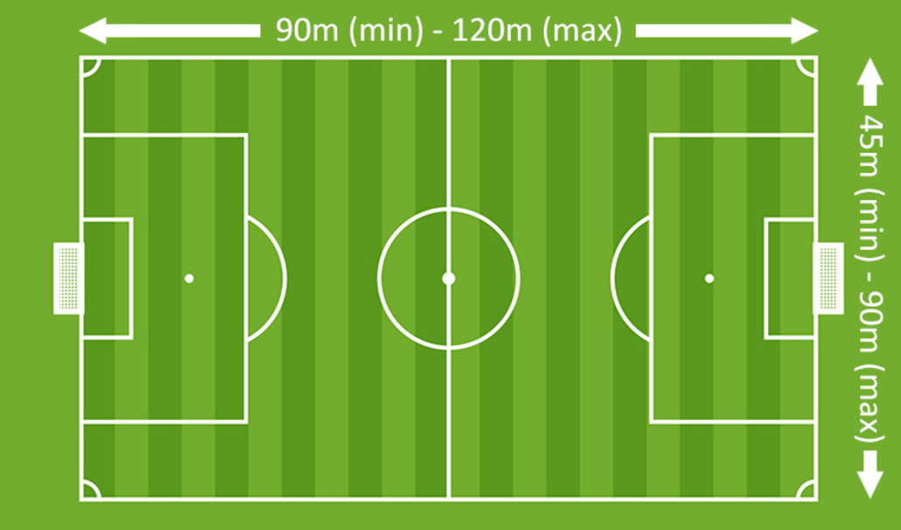
CEITEC Nano Cleanroom - Nanocharacterization and Nanofabrication
30 m
60 m
ISO 8 cleanroom (class 100,000), ISO 5 cleanroom (class 100)

Slide 4
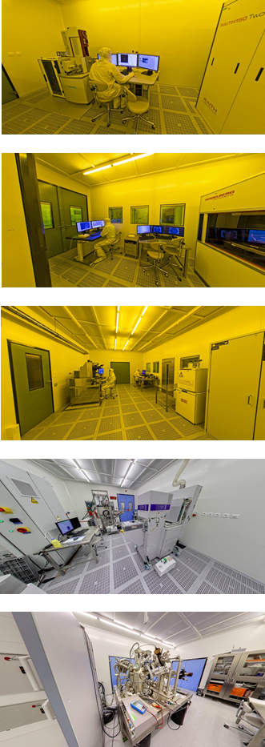
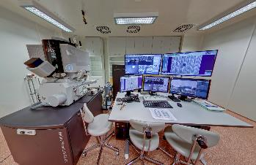
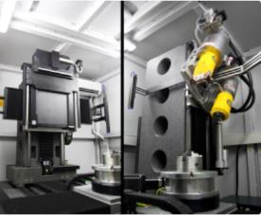
CEITEC Nano Labs
Nanofabrication | Nanocharacterization | Structural analysis | X-ray CT
Lithography EBL, FIB, UV, laser scanning, nanoimprint Chemical lab Wet benches, multiple processes (Plasma)chemical and thermal processes LPCVD, ALD, MOCVD PECVD, RIE, DRIE IBE, RIBE, CAIBE Depositions (PVD) Magnetron sputtering E-beam evaporator IBAD Packaging Wire bonder Laser dicer | Microscopy SEM/FIB, SPM, SNOM, Kerr microscopy UHV techniques XPS Scanning Auger microscopy SIMS, LEIS UHV complex system Elmag measurements 9T, 1.4K ppms LT probe station Automated probe station High-temperature probe station Optical measurements - VUV-VIS-MIR spectroscopic ellipsometers and spectrometers, FTIR microscope | Microscopy HRTEM HRSEM with EDS, WDS FIB/SEM Sample preparation (TEM lamella, sample polishing) X-ray diffraction High-resolution X-ray diffractometer Powder diffractometer | Computer tomography Micro CT Nano CT

Slide 5
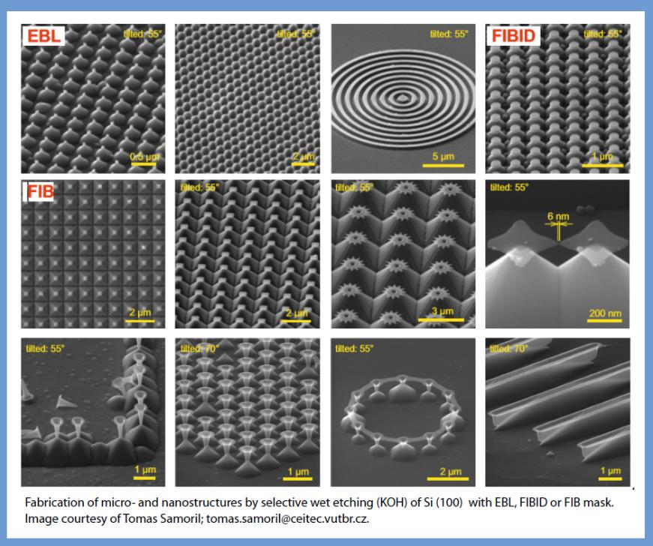
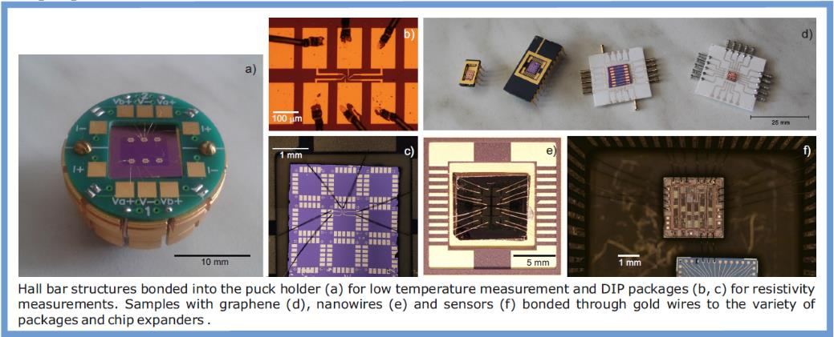
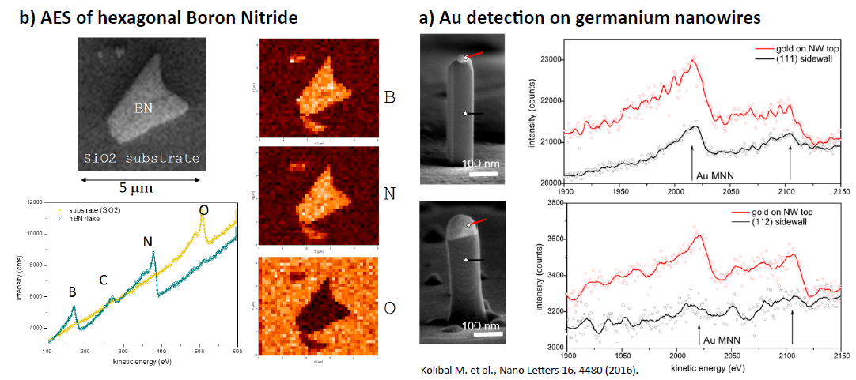
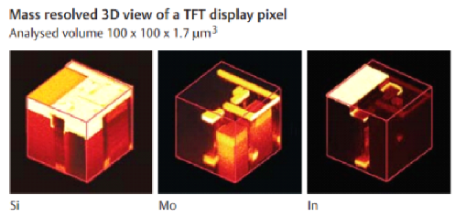
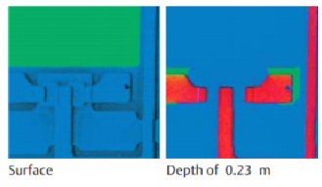
Examples from CEITEC Nano – fabrication & analysis
Lithography – structured materials
TEST Devices
Chemical analysis – Scanning Auger Microscopy
Chemical analysis - SIMS

Slide 6
User policy – Commercial users
1. self-service access
2. purchase of services
This is the preffered way how to use CEITEC Nano. It allows the most effective use of the equipment, promotes collaboration, knowledge transfer and exchange of ideas between researchers.
Especially suitable for long-term research, requires commitment to learn how to operate the instru-ments.
Users pay a training fee of 1,200 € per calendar year per user and hourly rate for equipment (approx. 120 €/hour).
No IP problems
Samples are handled by RI staff. Suitable for occasional users, where training is unfeasible.
Not very effective, limited working hours. No interaction between researchers.
Users pay an hourly rate of ~ 200 €
(this fee covers instrument running costs depreciation and operator’s wage)
Potential problems with IP
http://nano.ceitec.cz

Slide 7
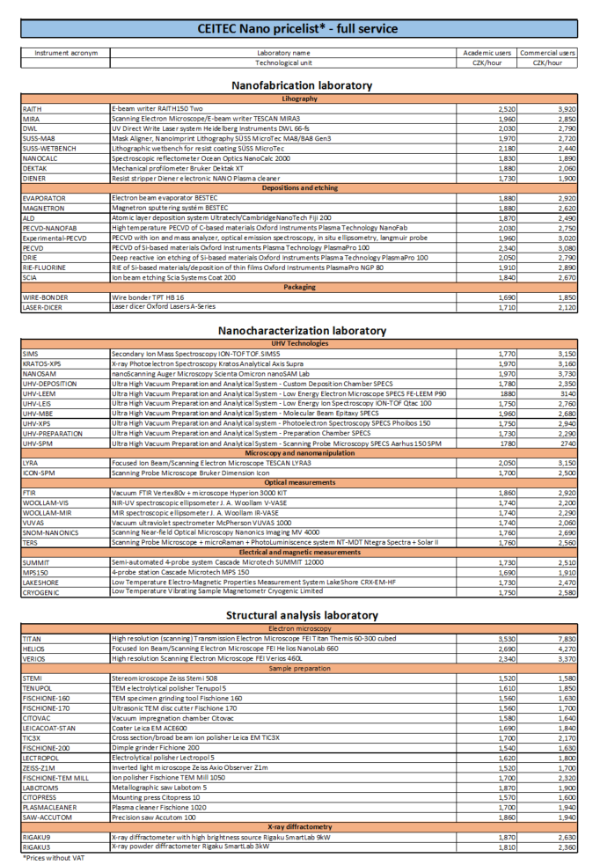
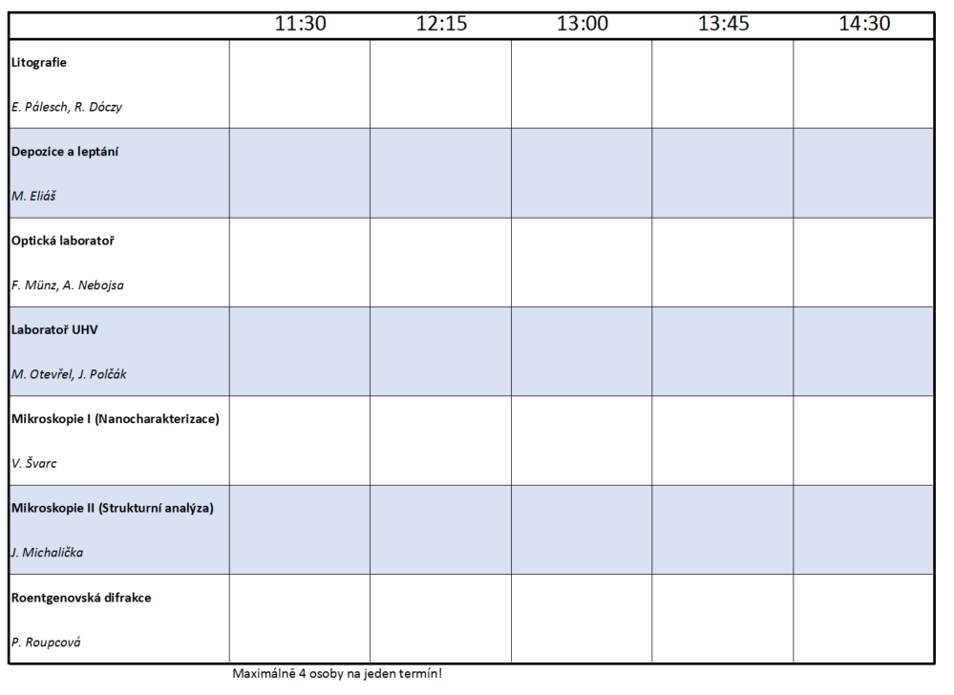
Group excursions 11:15 and 12:45, building C, 1st floor
Specific instrument excursions/consultations – please register:

Slide 8
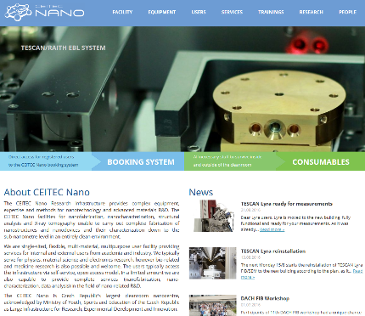
Thank you for your attention!
http://nano.ceitec.cz

