Slide 1
Core Facility at CEITEC BUT
David Škoda
CEITEC BUT
Brno, 10 June 2013

Slide 2
CORE FACILITY “definition”
Core facilities can be defined as
centralized shared resources
that provide access to instruments, technologies, services, as well as expert consultation and other services to scientific investigators.
The typical core facility is a discrete unit with in an institution and has dedicated personnel, equipment, and space for operations.

Slide 3
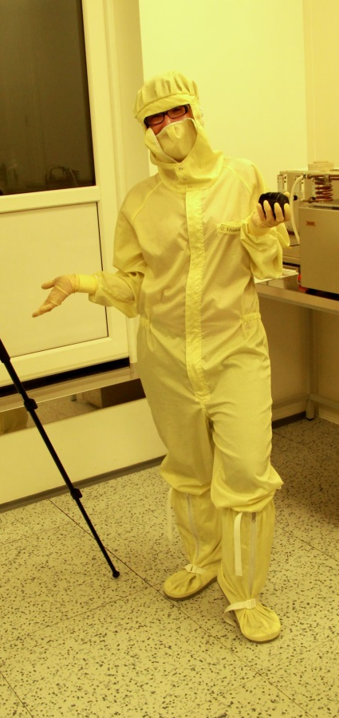
… in scientific meaning
scientist

Slide 4
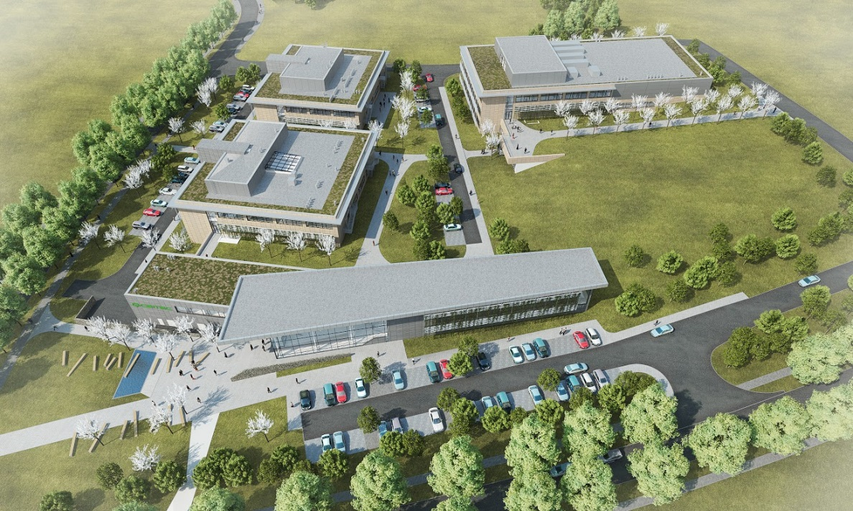
… in scientific meaning
scientist
infrastructure of CEITEC core facilities

Slide 5
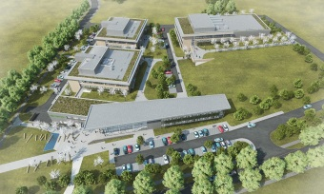
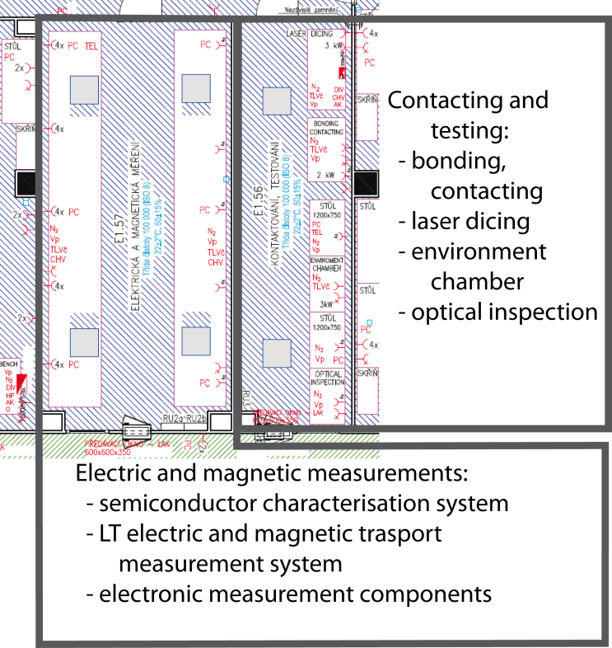
… in scientific meaning
scientist
equipped laboratories

Slide 6
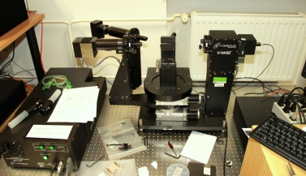
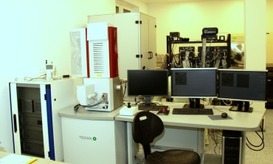
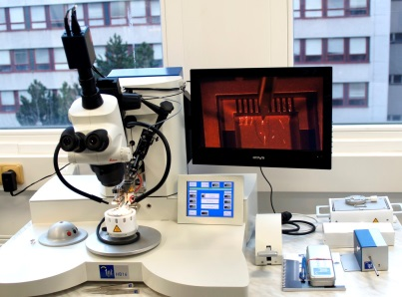
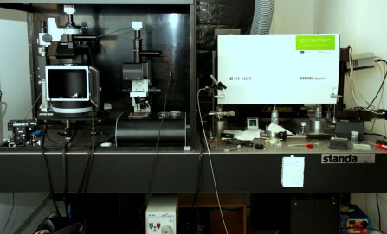
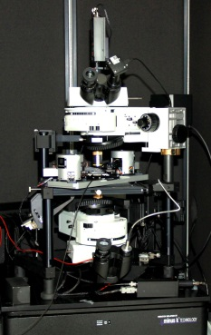
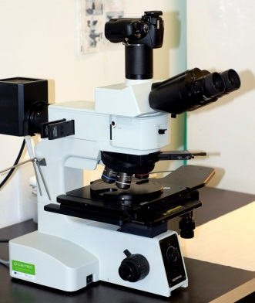
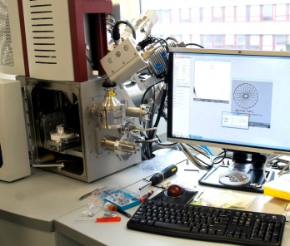
… in scientific meaning
scientist
25/8/367 of laboratory work

Slide 7
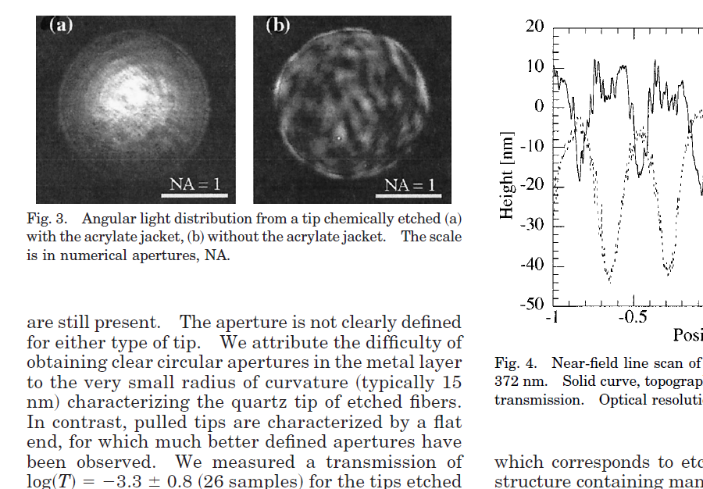
… in scientific meaning
scientist
Result - publication, cooperation,
fundamental and application research

Slide 8
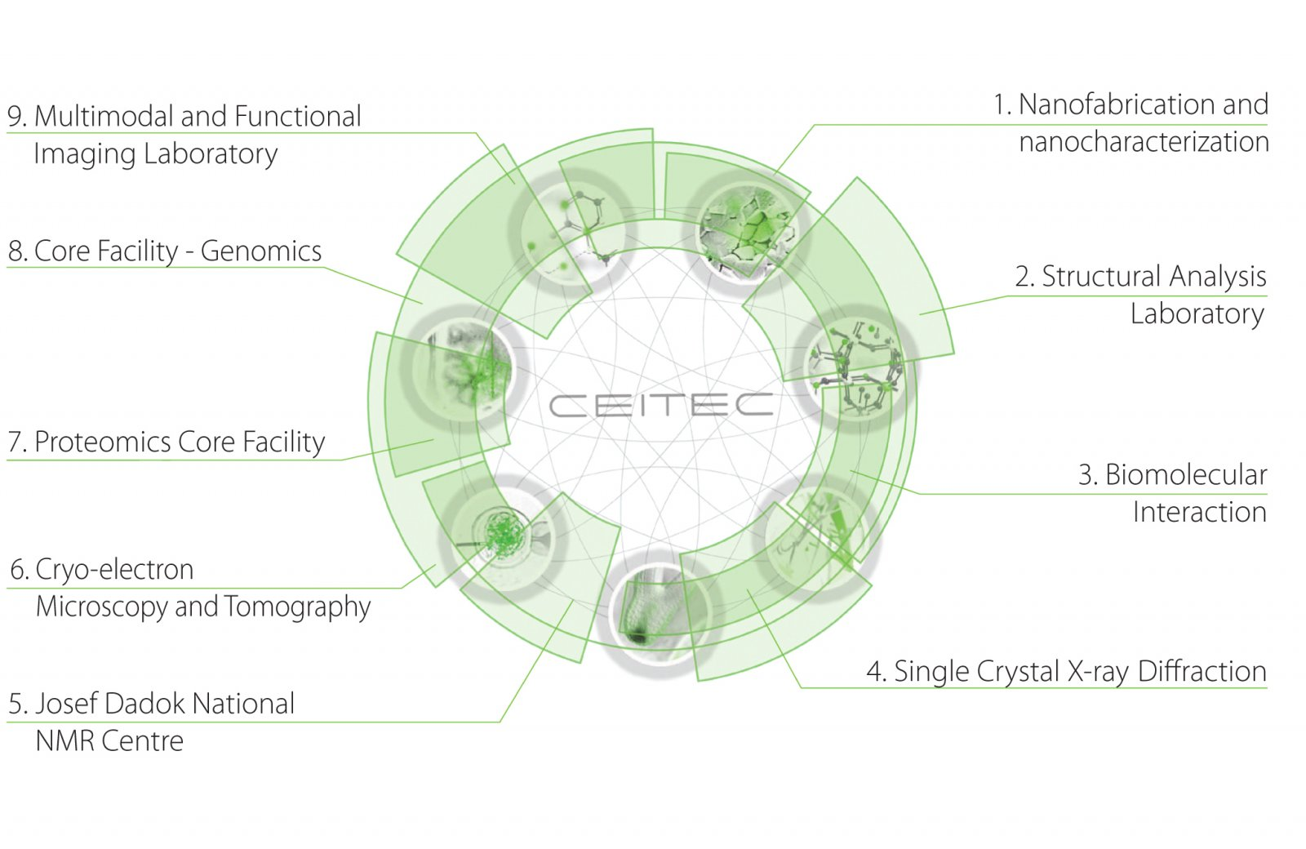
CORE FACILITY at CEITEC
CEITEC BUT

Slide 9
Background of CORE FACILITIES at CEITEC BUT
vision of research CEITEC BUT programme
RP1: Advanced Nanotechnologies and Microtechnologies
preparation, characterization and analysis of the properties of nanostructures (semiconductor nanostructures, magnetic and metallic nanostructures, nanotubes and nanofibers)
RP2: Advanced Materials
advanced methods of synthesis, preparing of advanced materials and multifunctional composites with polymeric, ceramic, silicate or metallic matrixes, characterization of their structures on various dimensional scales and quantifying structure-property-function relationships on the various structural levels

Slide 10
CORE FACILITIES - construction site
CFs
April 2012

Slide 11
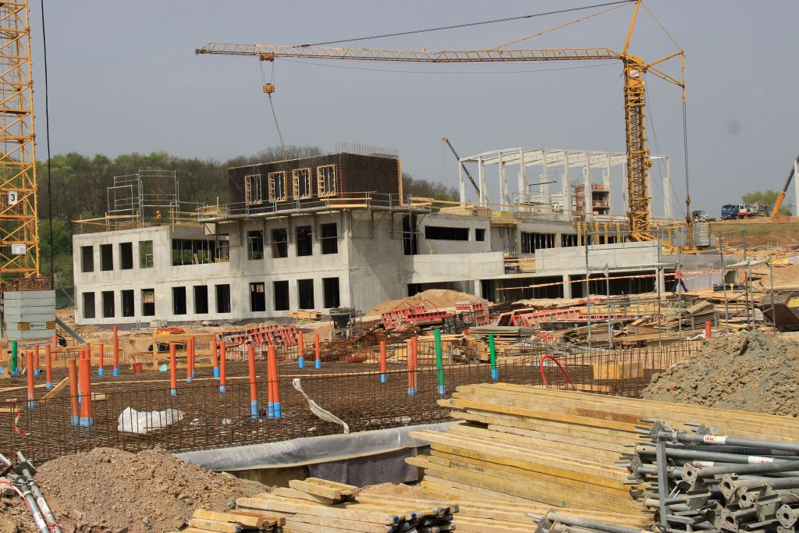
CORE FACILITIES - construction site
CFs
April 2012 -> April 2013

Slide 12
CORE FACILITIES - construction site
CFs
CFs
April 2012 -> April 2013 -> August 2014

Slide 13
CORE FACILITIES - construction site
current situation:
CFs under construction – no clean labs of sufficient areas
RP1, RP2 - wide spectrum of interests
continuous scientific work
collaborations
problem solution:
purchasing a part of CF instruments + temporal installation (BUT, MU)
sharing the instrument in established RG (RP1, RP2) laboratories
cooperation with other institutions (universities, AS, CF)
CFs
CFs
April 2012 -> April 2013 -> August 2014

Slide 14
Key equipment of CFs at CEITEC BUT

Slide 15
FIB/SEM – Tescan Lyra3 XMH

Slide 16
FIB/SEM – Tescan Lyra3 XMH
FEG SEM
U = 200 V – 30 kV
I = 2 pA – 200 nA
resolution < 1,2 nm with 30 kV
detectors
SE, BSE, TE
In-beam SE a BSE
EBIC
Focused Ion Beam - Ga Liquid Metal Ion Source
U = 0,5 kV – 30 kV
I = 1 pA – 40 nA
resolution < 5nm with 30 kV
Gas Injection System
5 precursors - Pt, W, SiO₂, H₂O, XEF₂
4 nanomanipulators
EDX
installed at BUT, CLR
9
10

Slide 17
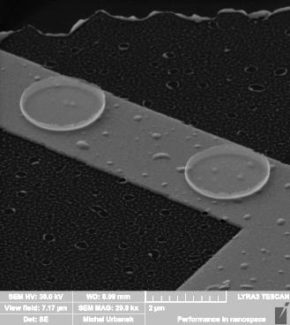
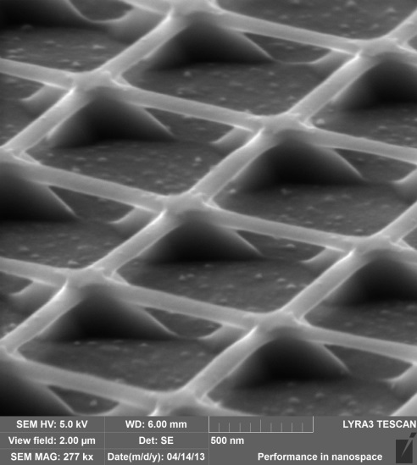
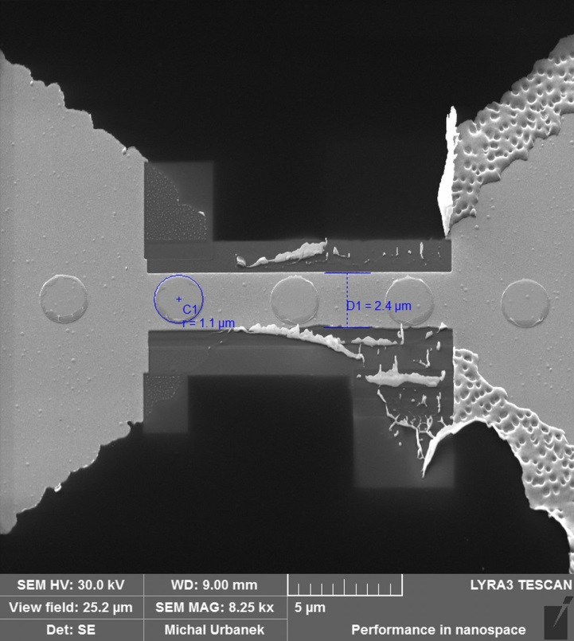
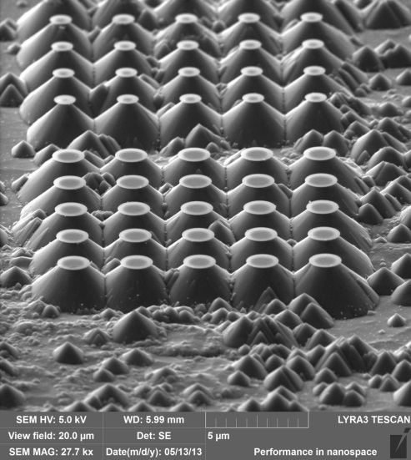
FIB/SEM – Tescan Lyra3 XMH
magnetic nanodisks
fabrication (EBL, FIB )
selective Si etching (IBD, GIS)
Dynamic switching of the spin circulation …
V. Uhlíř, M. Urbánek, T. Šikola et al.
Nature Nanotechnology, Volume: 8 Issue: 5, 2013
10

Slide 18
SNOM - Nanonics MultiView 4000
11

Slide 19
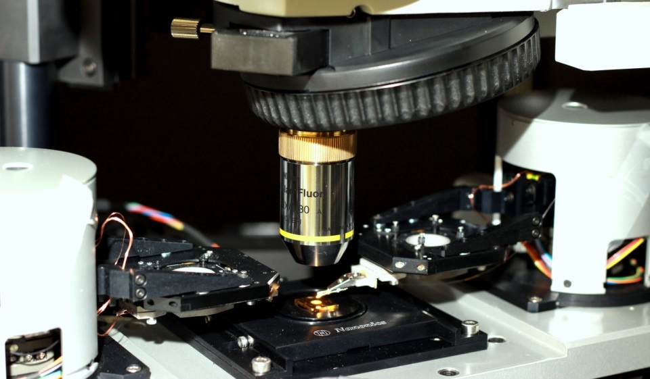
SNOM - Nanonics MultiView 4000
two-independent probe scanning system, sample scanning
SNOM, AFM, STM
combined SNOM collection, illumination with reflection and transmission modes
probes - sort of bent optical fibres
tuning fork according to applications
optical and acoustic hoods
Detectors:
APD (VIS) + PMT (NIR)
Lasers:
fiber coupler + bandpass filters
Nd:YAG - 532 nm
HeNe - 632,8 nm
odkaz na beziho
2-probe SNOM system
installed at MU, CLR
11

Slide 20
SNOM - Nanonics MultiView 4000
topography
SNOM
binary sample
topography
SNOM
4-way evanescent
way interaction
Control and Near-Field Detection …
P. Dvořák, T. Neuman, T. Šikola et al.
Nano Letters, May 2013

Slide 21
FT – IR Bruker Vertex 80v + Hyperion 3000

Slide 22
FT – IR Bruker Vertex 80v + Hyperion 3000
FT-IR – Vertex 80v
spectr. range 10 – 15 000 cm-1
detector 4 000-15 000 cm-1
reflection and transmission
IR microscope – Hyperion 3000
spectr. range 600 – 7 000 cm-1
detector 900-4 000 cm-1 (array)
up to 32x zoom (IR)
ATR
optical and acoustic hoods
installed at MU
13

Slide 23
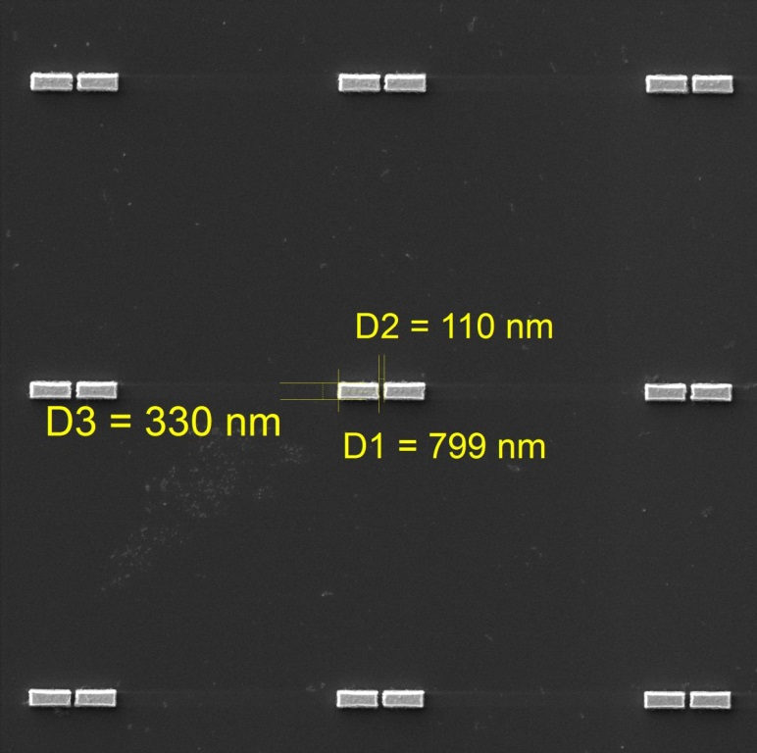
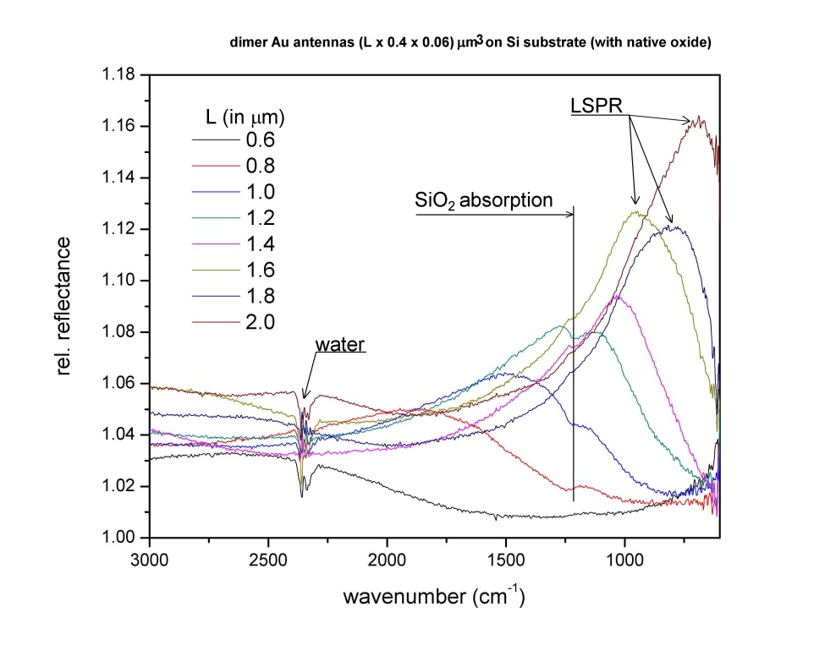
FT – IR Bruker Vertex 80v + Hyperion 3000
plasmonic antennas optimized for IR region
IR reflectance
13

Slide 24
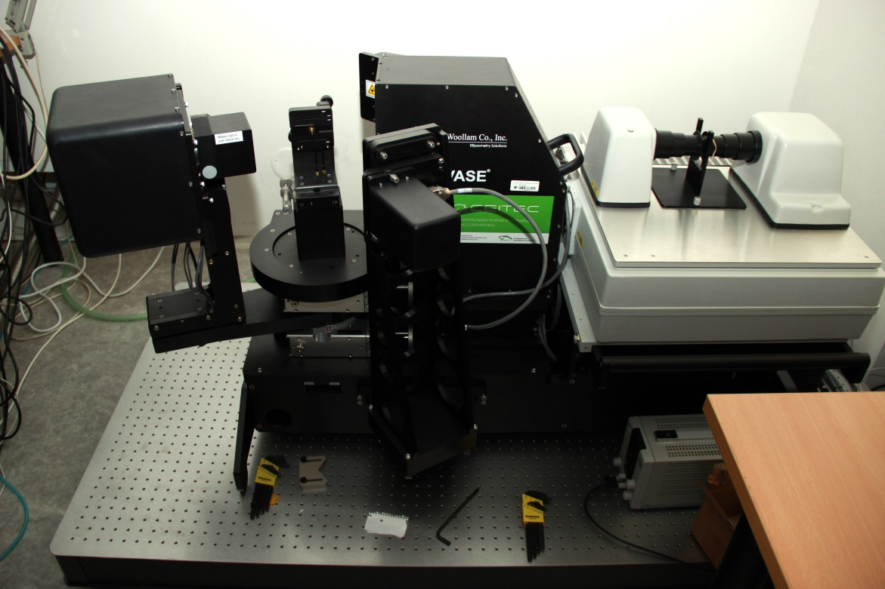
Spectroscopic ellipsometry NUV – FIR J. A. Woollam
unique instruments
components for newly built vacuum chamber
forming the RP1 objectives DEVELOPMENT OF NEW TECHNIQUES AND METHODS
installed at MU
12

Slide 25
Spectroscopic ellipsometry NUV – FIR J. A. Woollam
Woollam IR-VASE
spectroscopic ellipsometer for mid infrared range
Fourier transform spectrometer, 1.7-3000 mm (300-7000 cm-1)
rotating compensator (CsI)
precise determination of Δ
determination of depolarization
Muller matrix
automated change of angle of incidence
Woollam VASE
two grating monochromator, 2500-190 nm
detectors InGaAs-Si + PMT
adjustable compensator (auto-retarder)
precise determination of Δ
determination of depolarization
Muller matrix
automated change of angle of incidence
installed at MU
12

Slide 26
Tescan Mira3 - lithography SEM
14

Slide 27
Tescan Mira3 - lithography SEM
FEG SEM – Tescan Mira3
U = 200 V – 30 kV
I = 2 pA – 200 nA
resolution < 1,2 nm with 30 kV
detectors
SE, In-beam SE
interferometric stage - Raith
resolution < 2 nm
repeatability < 40 nm
stitching field
lithographic software – Elphy Plus
GDSII compatibility
installed at MU, CLR
14

Slide 28
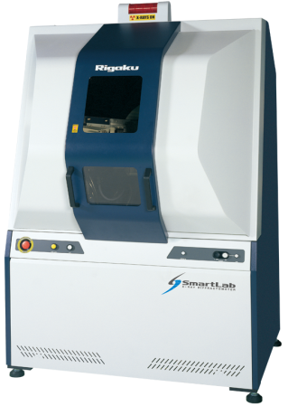
Diffractometer - Rigaku
11

Slide 29
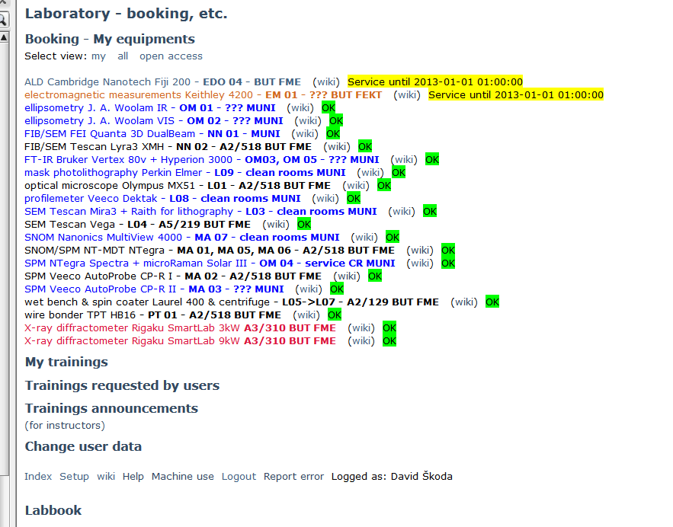
Booking system – monitoring the activities
web database of instruments

Slide 30
CF projects
ongoing projects:
CF Open Access
available and accessible for the external Czech and international research teams
20 % of lab time to external academic users for free
CEITEC instruments + shared instruments of RP1, RP2 group
http://www.ceitec.eu/project-ceitec-open-access/t1368

Slide 31
Thank you for your attention
Central European Institute of Technology
c/o Masaryk University
Žerotínovo nám. 9
601 77 Brno, Czech Republic
www.ceitec.eu | info@ceitec.cz

Slide 32
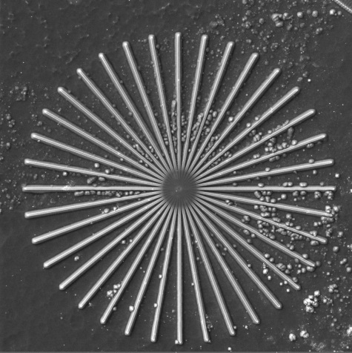
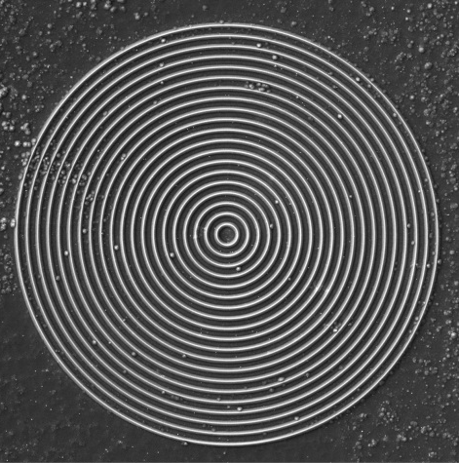
recently installed - Lithography SEM
Electron Beam Lithography
SEM objective
star
concentric
circles
interferometric stage
14

Slide 33
NTegra Spectra - SPM + μRaman -> TERS
15

Slide 34
recently installed - SPM + μRaman -> TERS
NTegra Spectra
SPM–
AFM, STM, MFM, …
cantilever, tuning fork
optical microscope –
NUV-VIS-NIR
Raman spectrometer –
EMCCD (VIS) + InGaAS (NIR)
grat. 150 + 600 + 1800 gr/mm, Echelle
Lasers
dual NUV/blue - 325nm + 441nm
green solid state - 532nm
NIR diode laser - 785nm
supercontinuum - 400-1600 nm, for luminescence and excitations
Tip Enhanced Raman Spectroscopy capable
installed at MU, CLR service
15

Slide 35
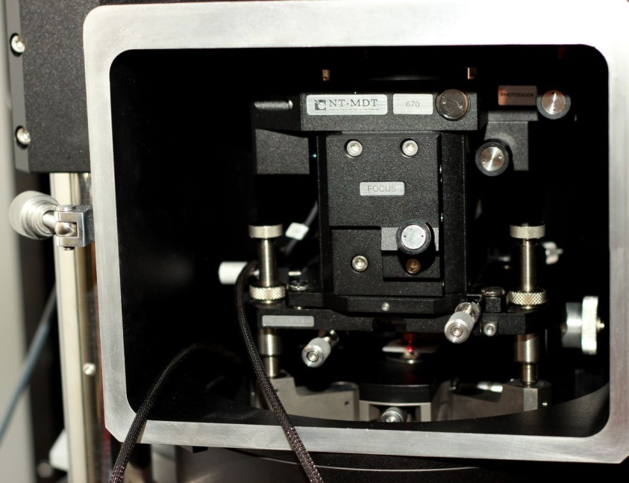
recently installed SPM + μRaman -> TERS
SPM dock station
Raman map of graphene flakes
15
Spectra 3 – Raman spectrometer

