Slide 1
Smart Polymers for Different Medical Applications
MATERIAL SCIENCES AT CEITEC BUT
November 7th, 2013 Technická 2, Brno
Advanced Polymers and Polymer Composite group (RG 2-3)
Abdel-Mohsen Abdel-Lattif
Notes:
1

Slide 2
Advanced Polymers and Polymer Composite (RG 2-3)
Group leader: Prof. Josef Jančář
Project leader: Ass. Prof. Lucy Vojtova
Raw materials
Energy
Characterization
Computer Simulations
Synthesis
Polymer
Processing
Product
Advanced polymers
„Smart“ polymers
Biomaterials
Nanocomposites
Application
Stability

Slide 3
Highlights of Advanced Polymers and Polymer Composite group
Temperature-sensitive hydrogels with the sol-gel phase transition at body temperature for drug delivery,
Release-controlled core-shell nanoparticles having “smart“ polymer shell and inorganic/metal core for medical applications,
Fluorescence biopolymers for diagnosis purposes,
Life-time controlled biopolymer composite scaffolds for soft and hard tissue engineering,
Antimicrobial nano- and micro- polymeric fibers for wound healing.

Slide 4
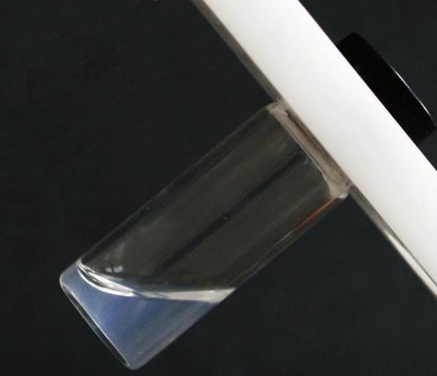
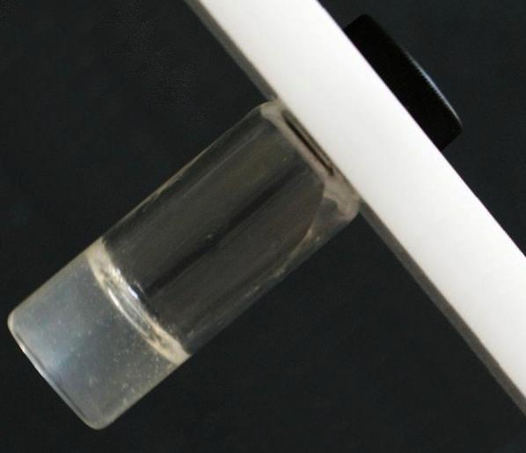
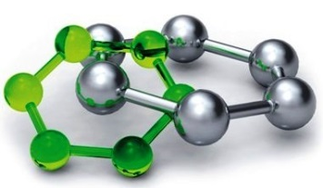
Definition
Temperature-responsive injectable polymers
„Smart“ polymers = stimulus-responsive polymers
(temperature, humidity, pH, the intensity of light, electrical or magnetic field)
sol
gel
heating
cooling
Polymeric materials that respond in a dramatic way to very slight changes in their environment.
Biomedical and industrial field = limitless applications

Slide 5
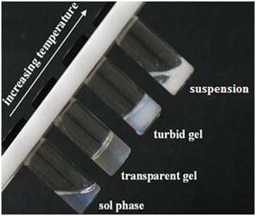
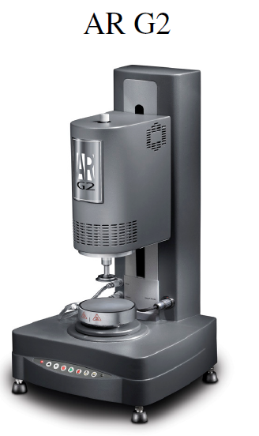
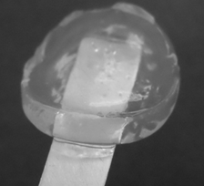
Temperature-responsive injectable polymers
PhD. students: L. Michlovská
Z. Vyroubalová I. Chamradová

Slide 6
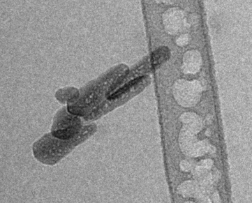
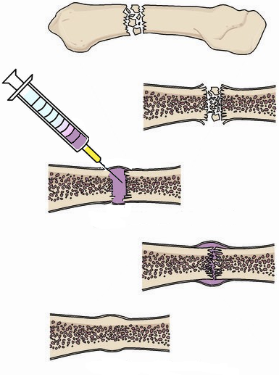
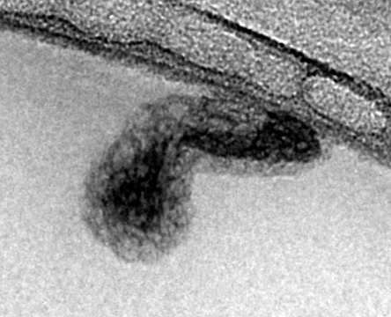
Core shell nanoparticles based on Synthesis nanocomposite
„smart“
organic
inorganic
Rod-like HAP nanoparticles
core
sharp interface
without polymer shell
shell
8 nm
TEM FEI Tecnai Sphera 20
Ing. Lubomír Kováčik, Ph.D.
Institute of Cellular Biology and Pathology
1st Faculty of Medicine, Charles University
Prague, Czech Republic
PhD student: I. Chamradová

Slide 7
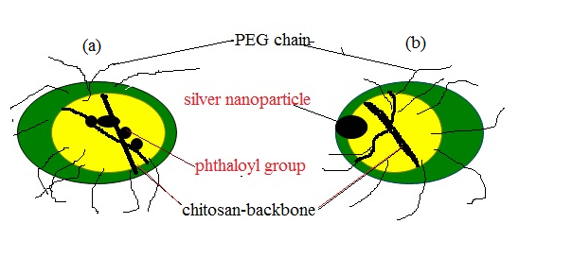
Core shell nanoparticles based on natural biopolymer

Slide 8
Application of core shell nanoparticles

Slide 9
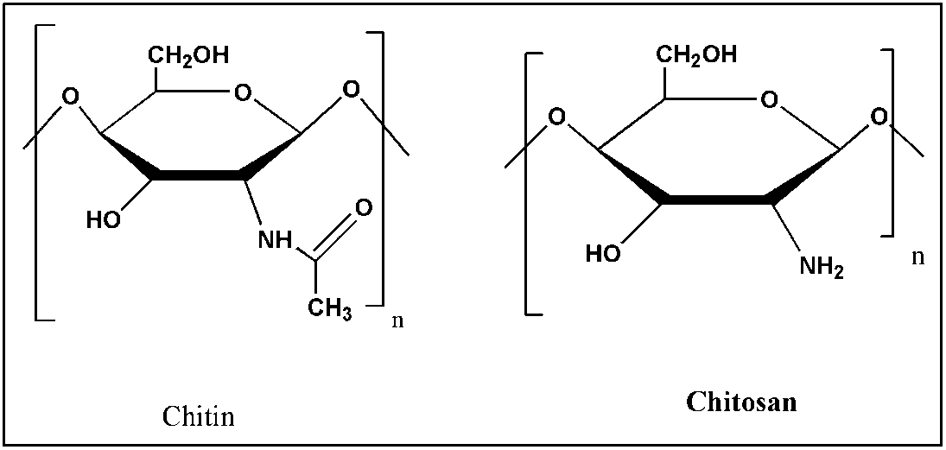
Application of natural polymer from animal source
R.M.Abdel-Rahman , A.M. Abdel-Mohsen, Lucy Vojtova, J. Jancar, under publication

Slide 10
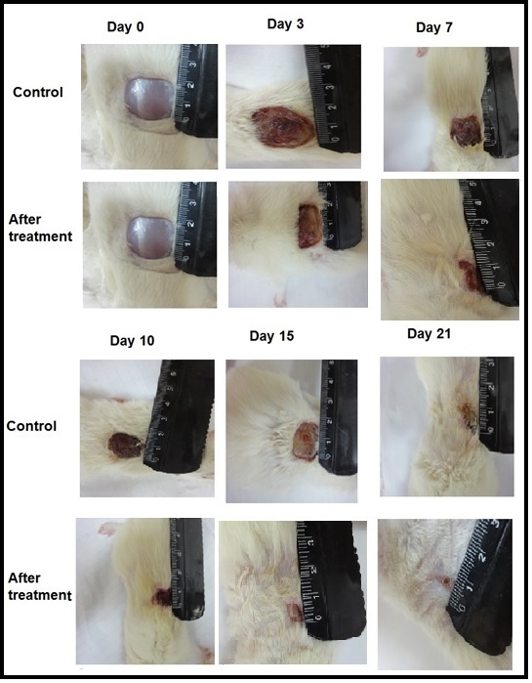
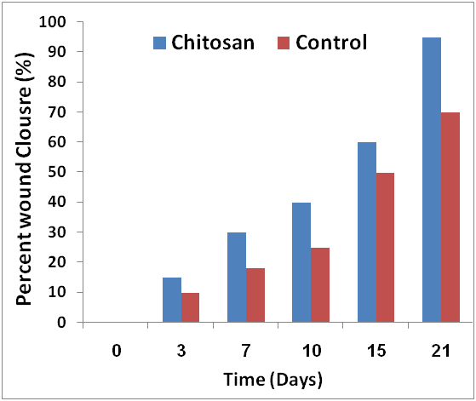
R.M.Abdel-Rahman , A.M. Abdel-Mohsen, Lucy Vojtova,
J. Jancar, under publication

Slide 11
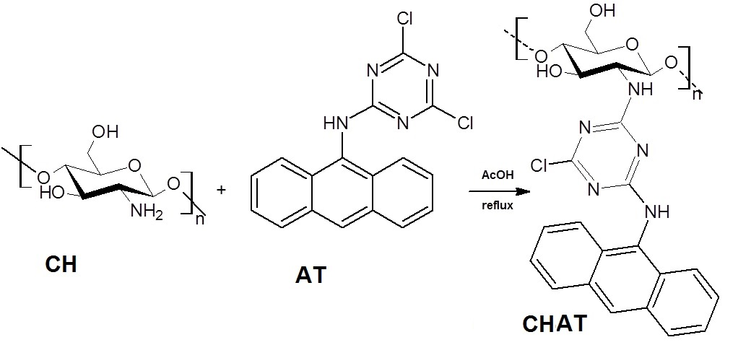
Florescence chitosan derivatives
A.M. Abdel-Mohsen, R.M.Abdel-Rahman, Lucy Vojtova, J. Jancar, under publication

Slide 12
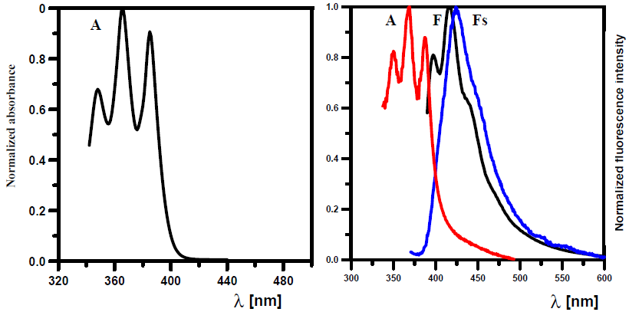
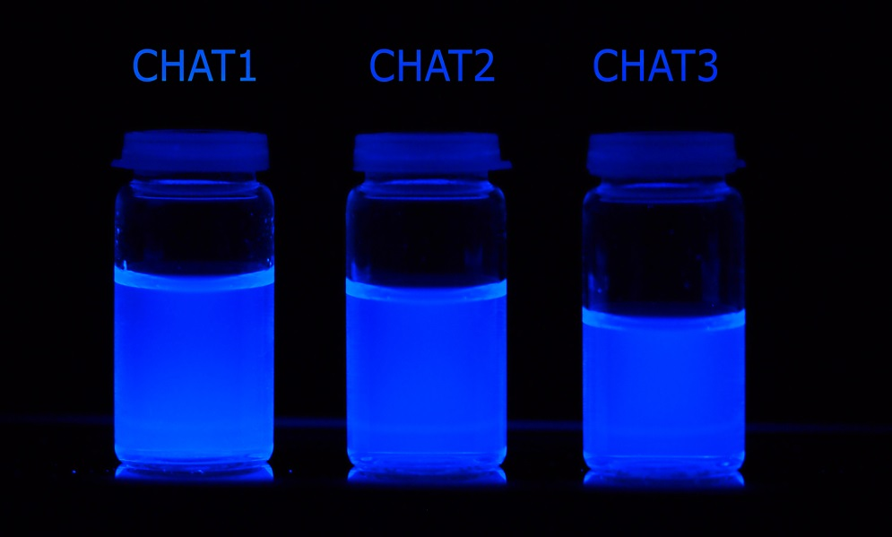
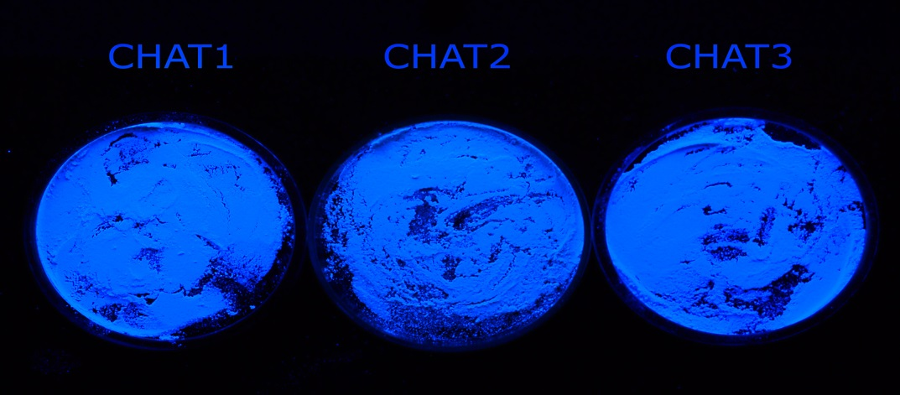
Florescence chitosan derivatives
A.M. Abdel-Mohsen, R.M.Abdel-Rahman, Lucy Vojtova, J. Jancar, under publication

Slide 13
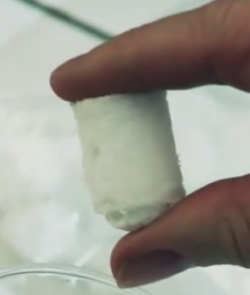
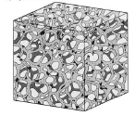
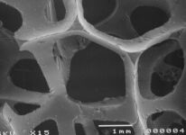
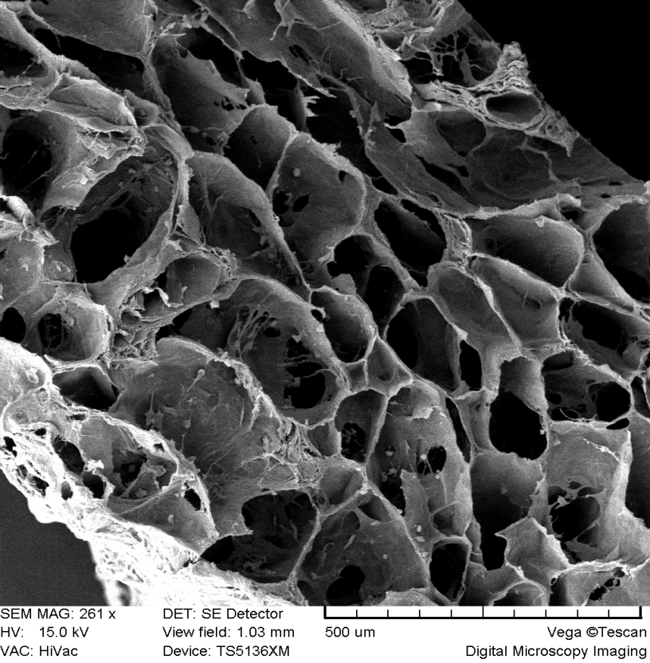
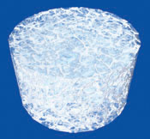
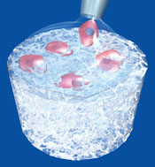
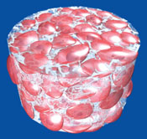
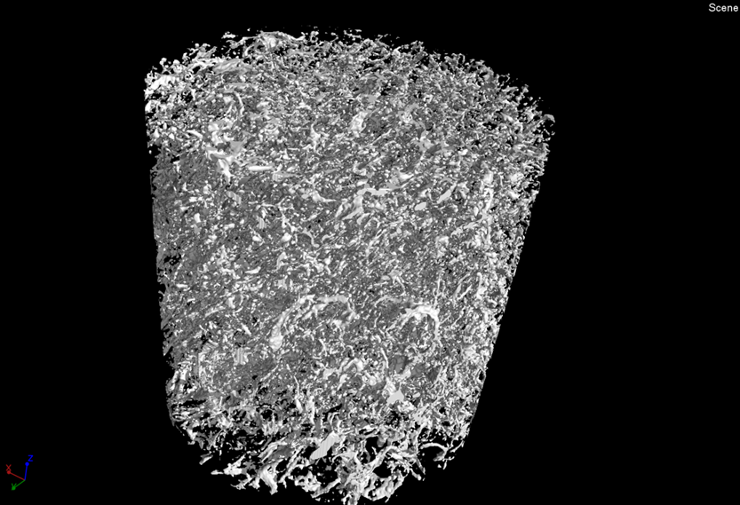
Biopolymer Scaffolds for Tissue Engineering
Scaffold with chondrocytes at 20th day.
3D scaffold
Cells seeding
Resorbable
bio-implant
PhD students: L. Zubal
L. Uhrová
SEM - MIRA-3 TESCAN
Masaryk University, Faculty of Medicine,
Department of Histology and Embryology
BRNO, Czech Republic

Slide 14
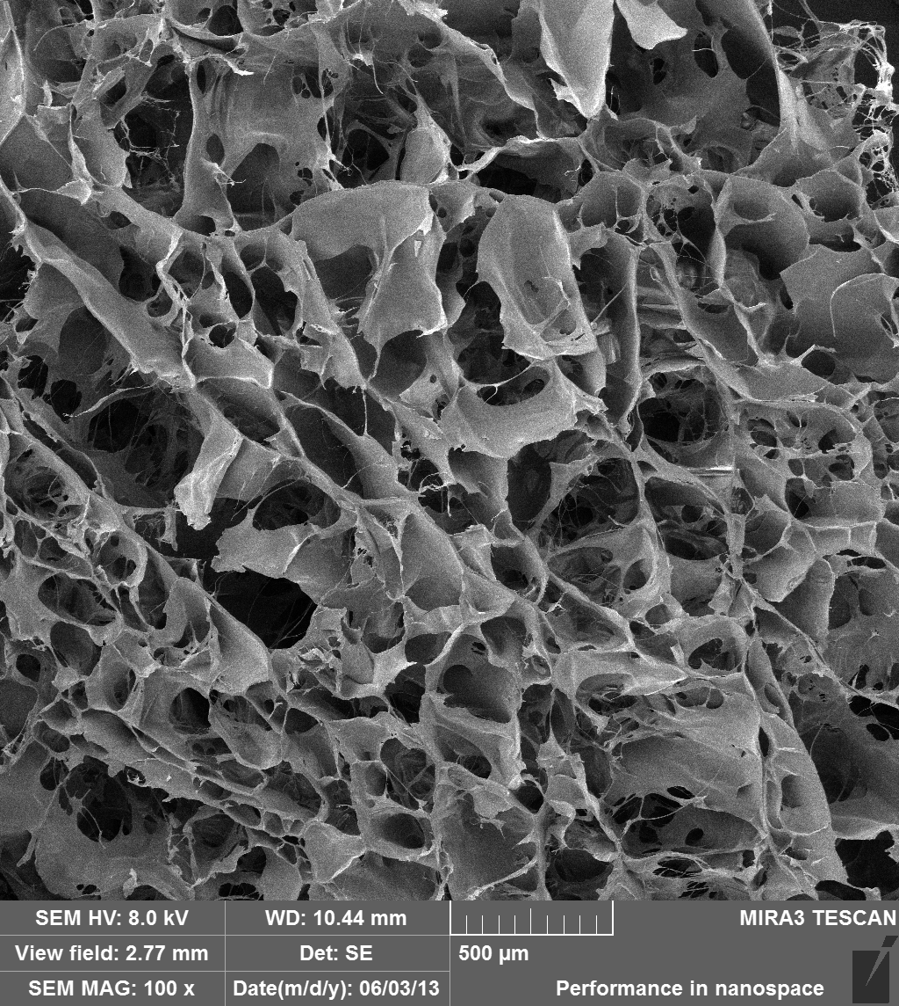
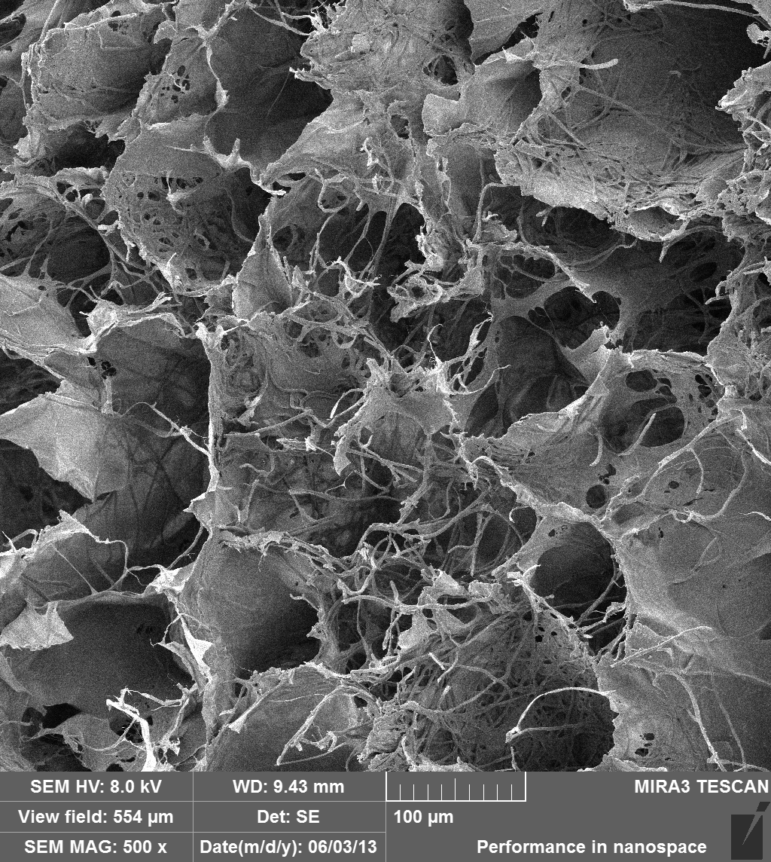
New scaffold material
Fluorescent Confocal Microscope
Ing. Eva Prosecká
Institute of Experimental Medicine
Department of Tissue Engineering ASCR, Prague, Czech Republic

Slide 15
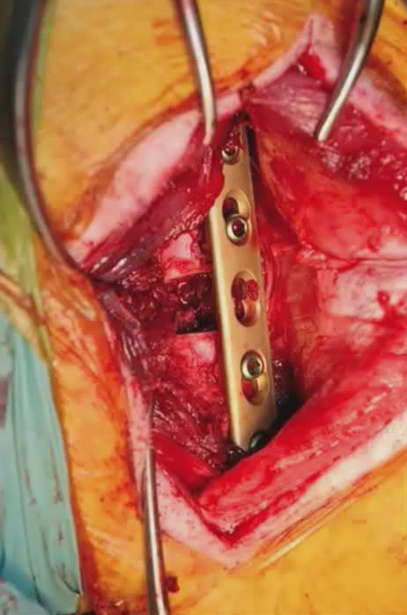
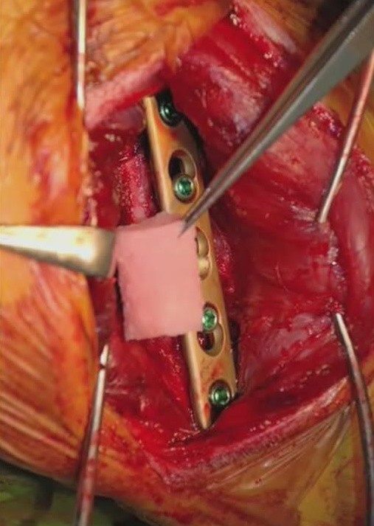
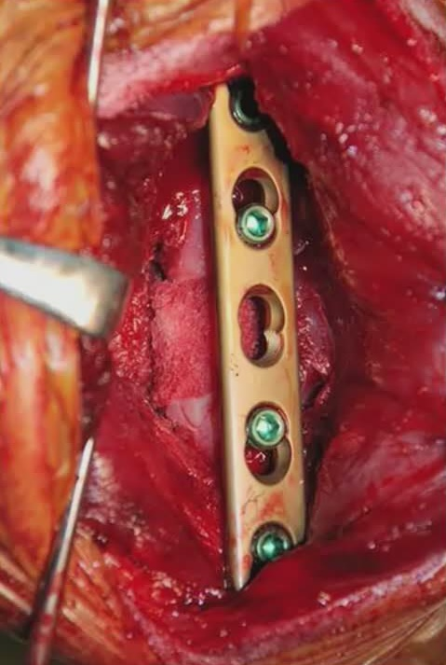
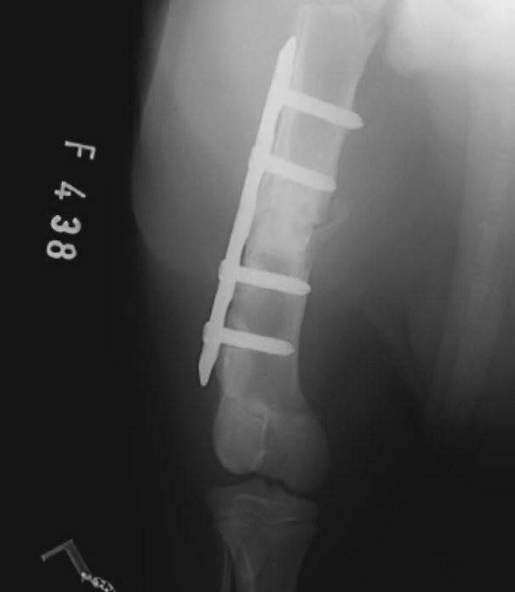
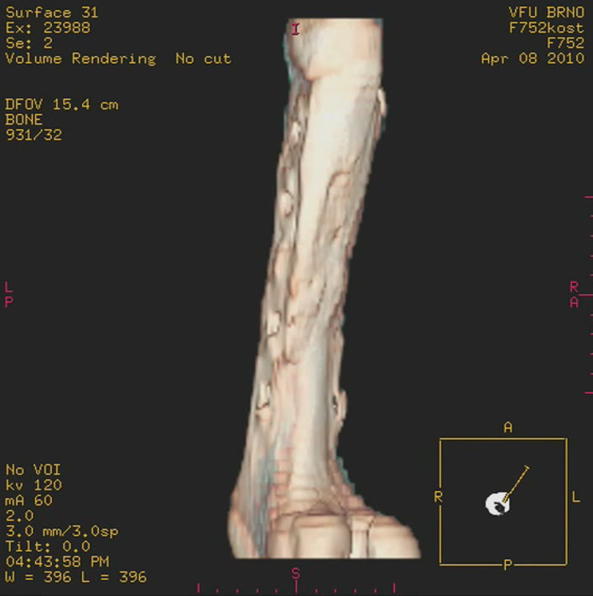
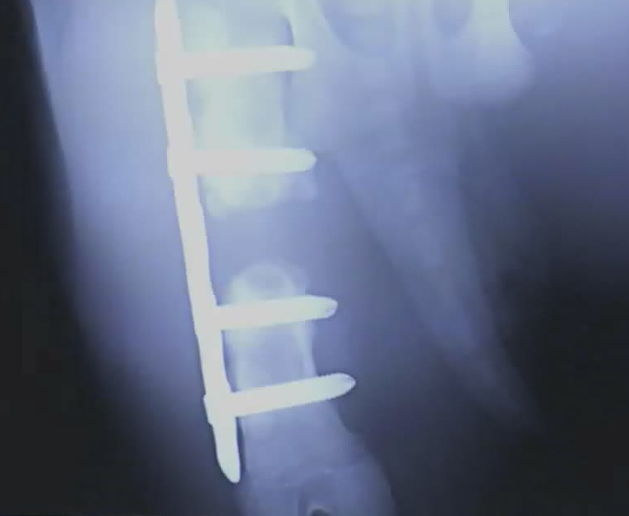
Segmental Fracture of Femural Bone Preclinical Testing, RTG, CT
Michal Crha, Alois Nečas, Robert Srnec, Jan Janovec, Ladislav Stehlík, Petr Raušer,Lucie Urbanová, Ladislav Plánka, Josef Jančář, Evžen Amler: ACTA VET. BRNO 2009, 78: 635-642

Slide 16
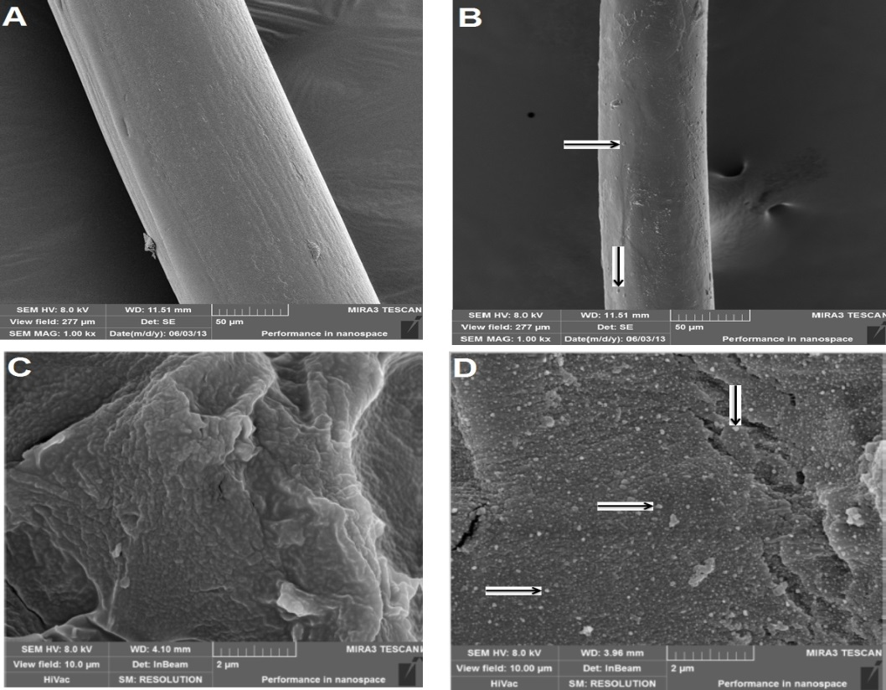
Functional fiber for medical application

Slide 17
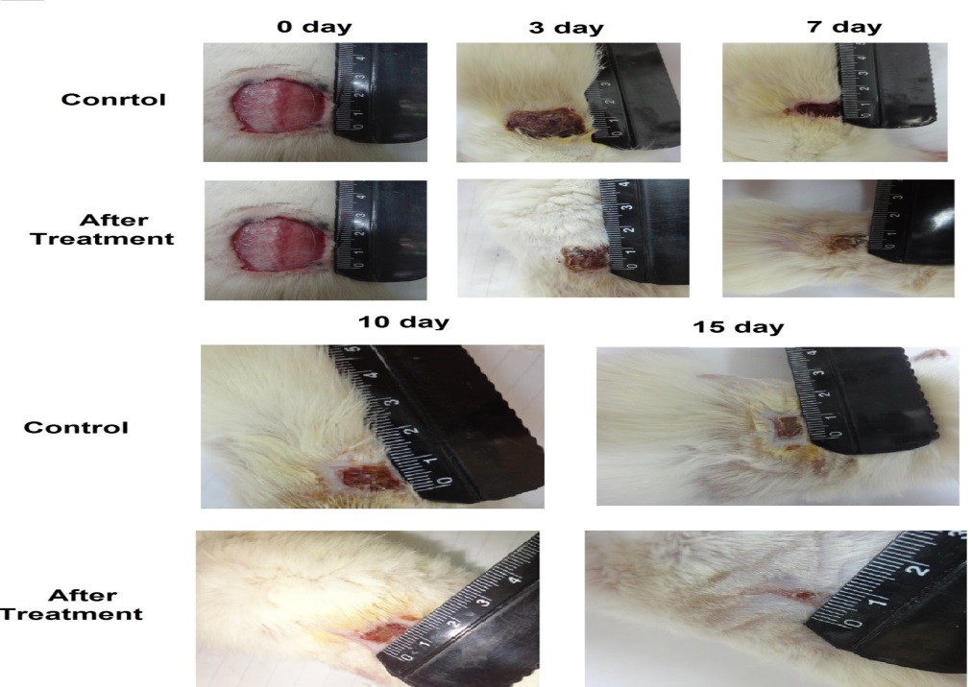
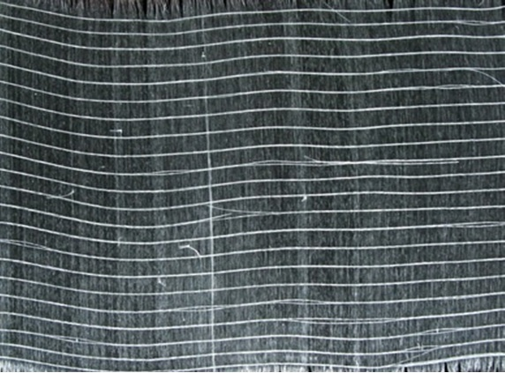
Application of the medical fiber
J. Jancar, R.M. Abdel-Rahman , L. Vojtova, A.M.Abdel-Mohsen
under publication

Slide 18
Nanofiber from natural polymers
PhD students: Veronika Svachova

Slide 19
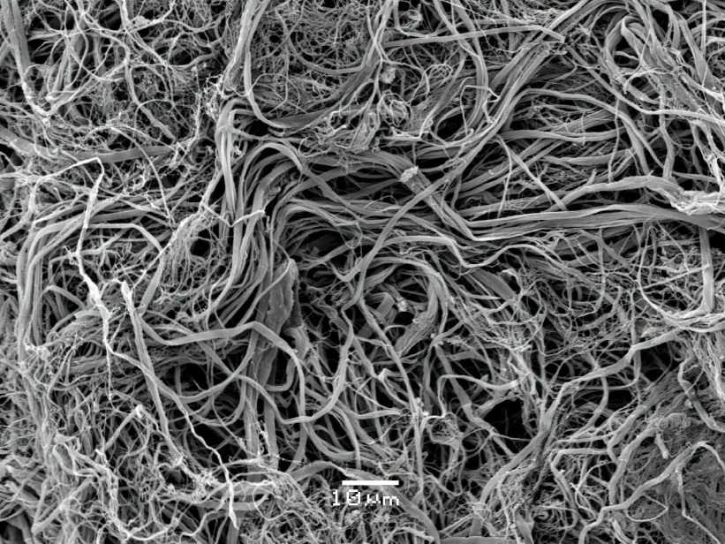
Short staple and microfiber from biopolymers

Slide 20
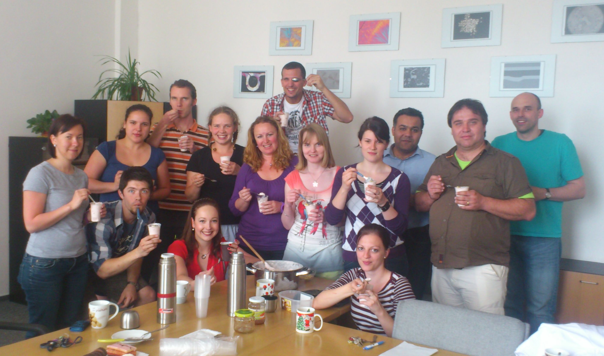
Acknowledgement: To project “CEITEC - Central European Institute of Technology” (CZ.1.05/1.1.00/02.0068) from European Regional Development Fund.
Thank you for your attention...

